Slide 1
Volunteers
FSPA
Organic Gardening Practices
Summer Interns
Mulching
Raised Beds
Minimizing the Work
Maximizing the Results
Compost & Compost Tea
Companion Planting
Black Plastic
Using Trellises
Mychorizal Innoculant
Manager
Sr. Lucy Slinger, FSPA, Ph. D.
Ecological Advocate
912 Market Street
La Crosse, WI 54601
www.fspa.org
5 Ton from an Acre
2010

Slide 2
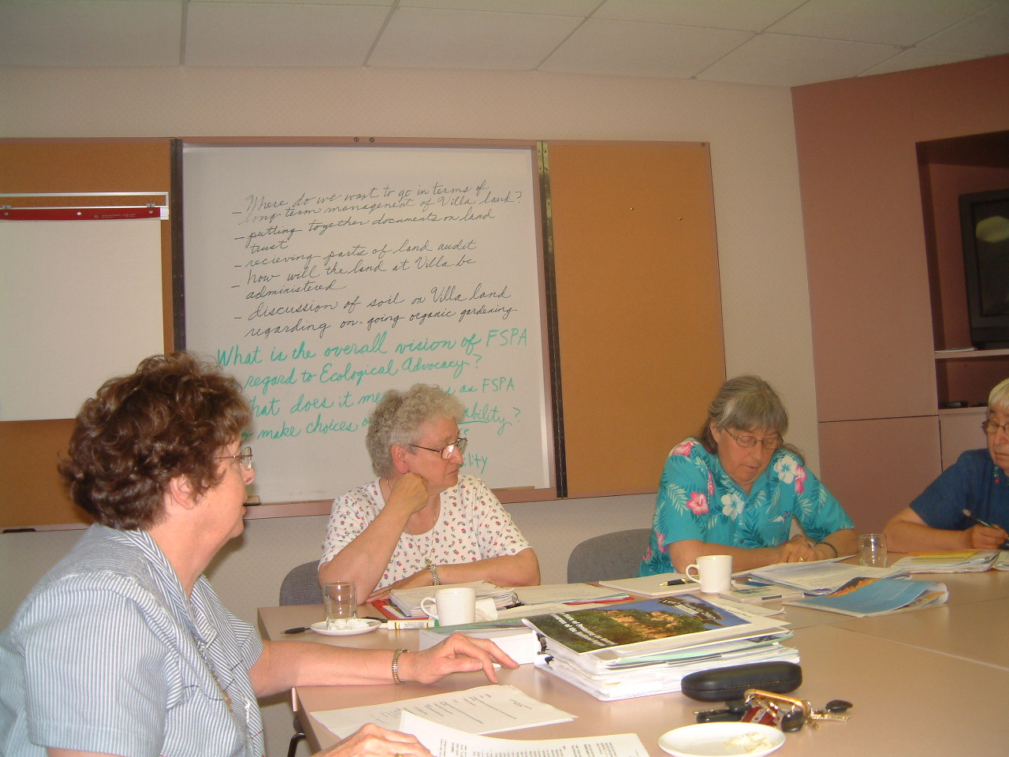
Ecospirituality
Committee Input

Slide 3
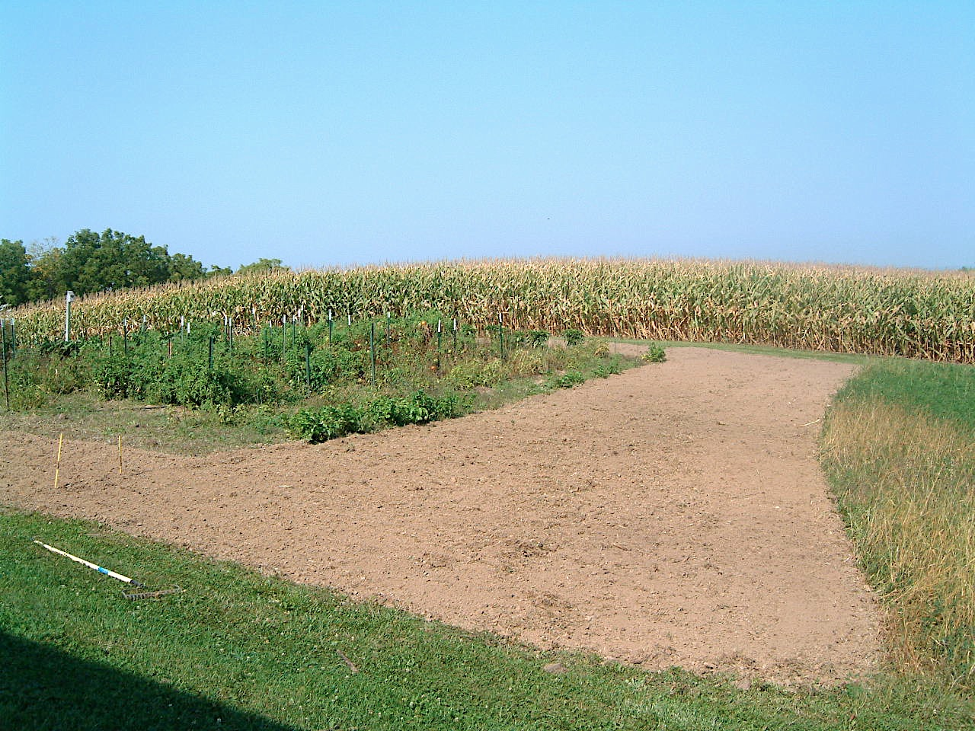
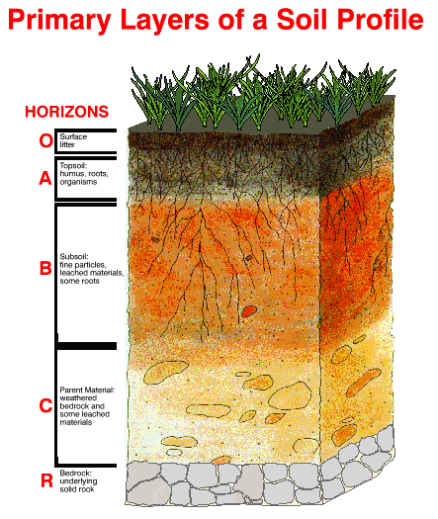
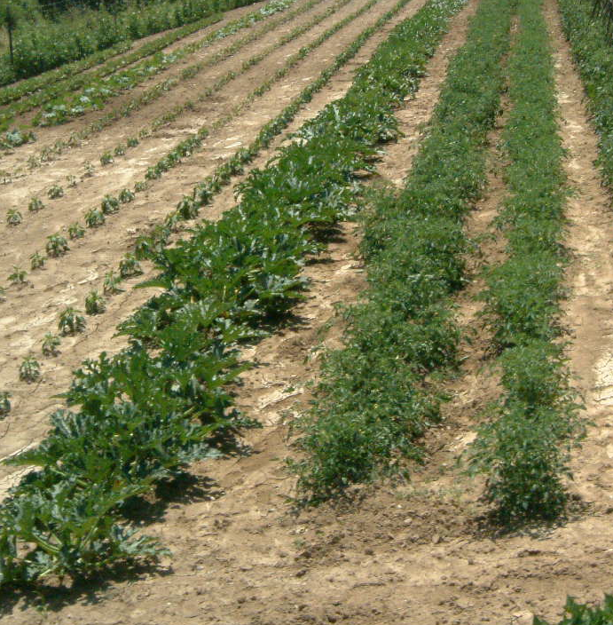
No top soil left
Conventional gardening

Slide 4
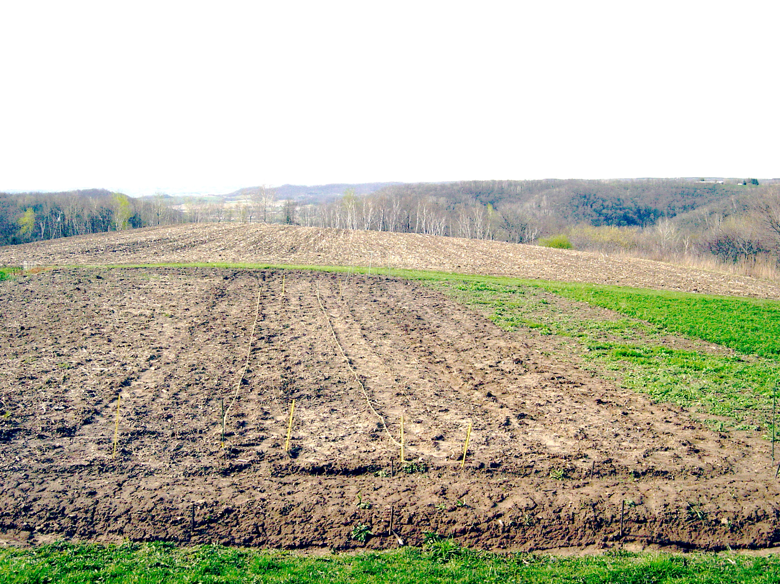
Compost
Enriched
Green manure
Heavy Clay Loam
B horizon

Slide 5
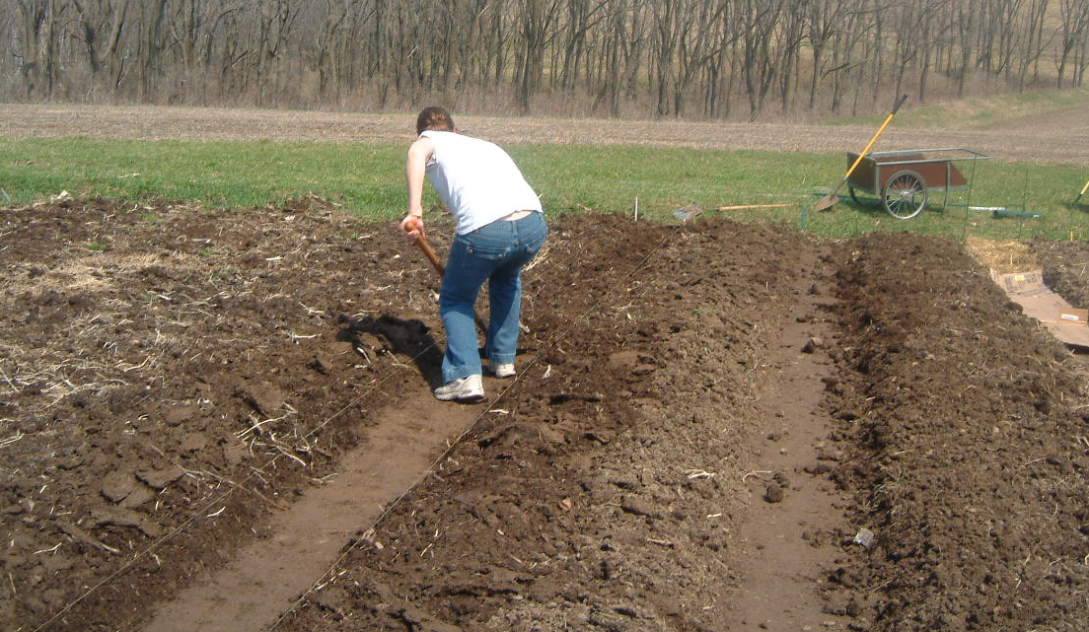
Growing Soil
Enriched
5 years
Raised beds
reduces soil compaction
Improves soil drainage
Increases soil humus

Slide 6
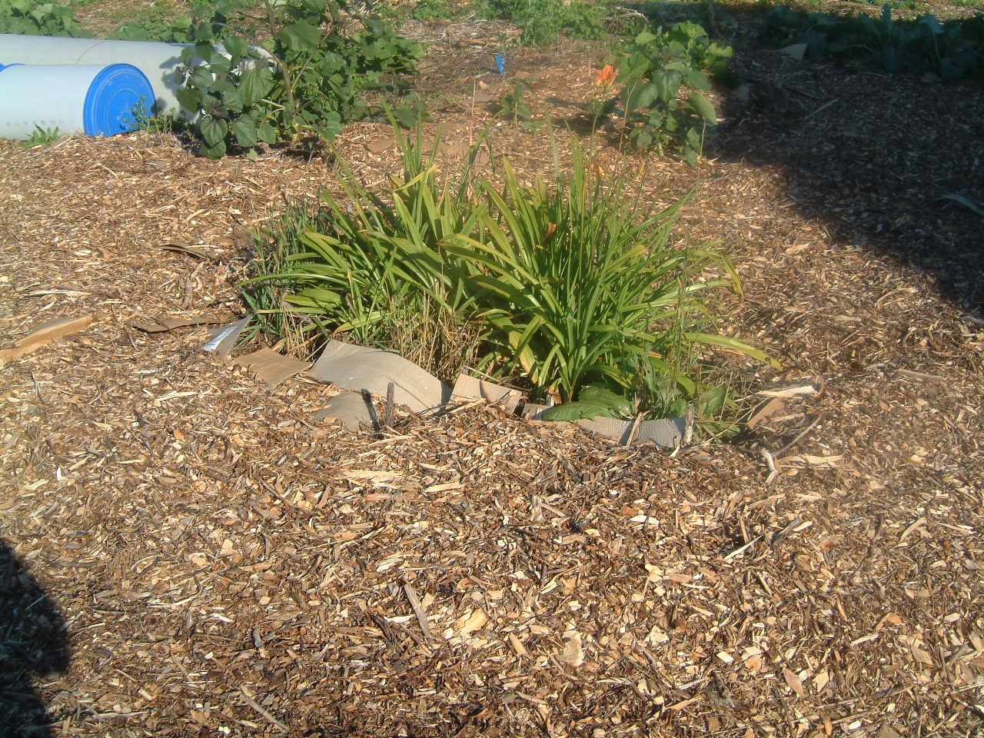
Mulching
Cardboard with Woodchips

Slide 7
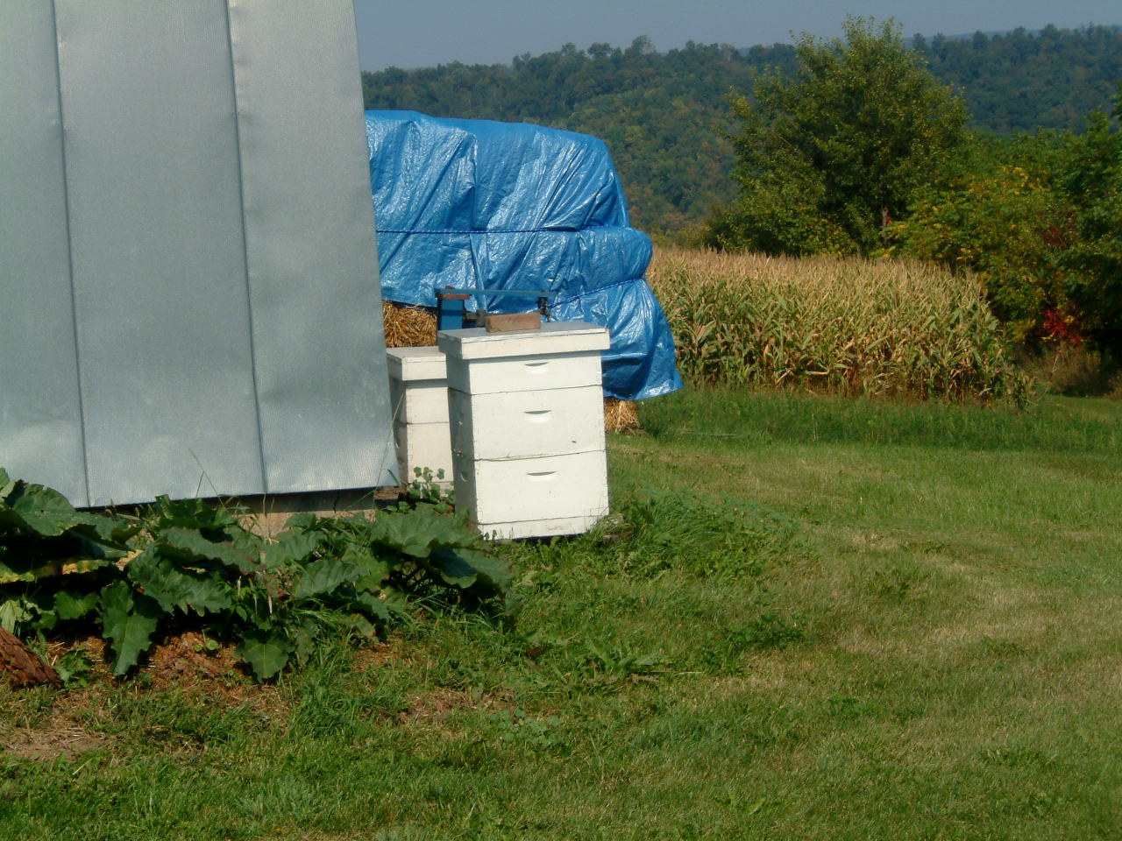
Honey Bees
for
Pollination
Mulch we use
Old Hay
Straw
Cardboard

Slide 8
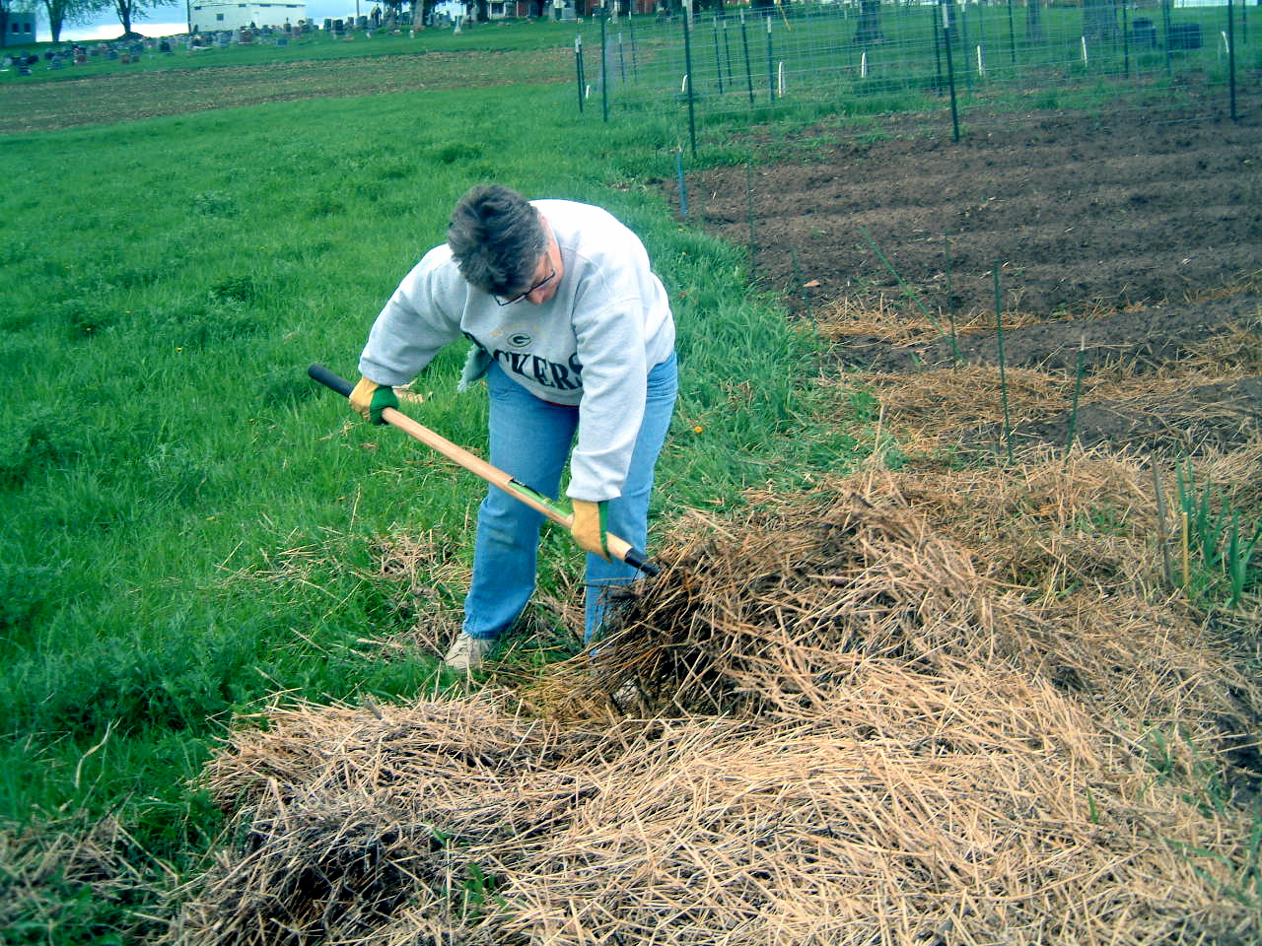
Prevents weed growth
Soil flora & fauna food
Prevents soil erosion
Retains soil moisture
Increases soil humus
Why Mulch?

Slide 9
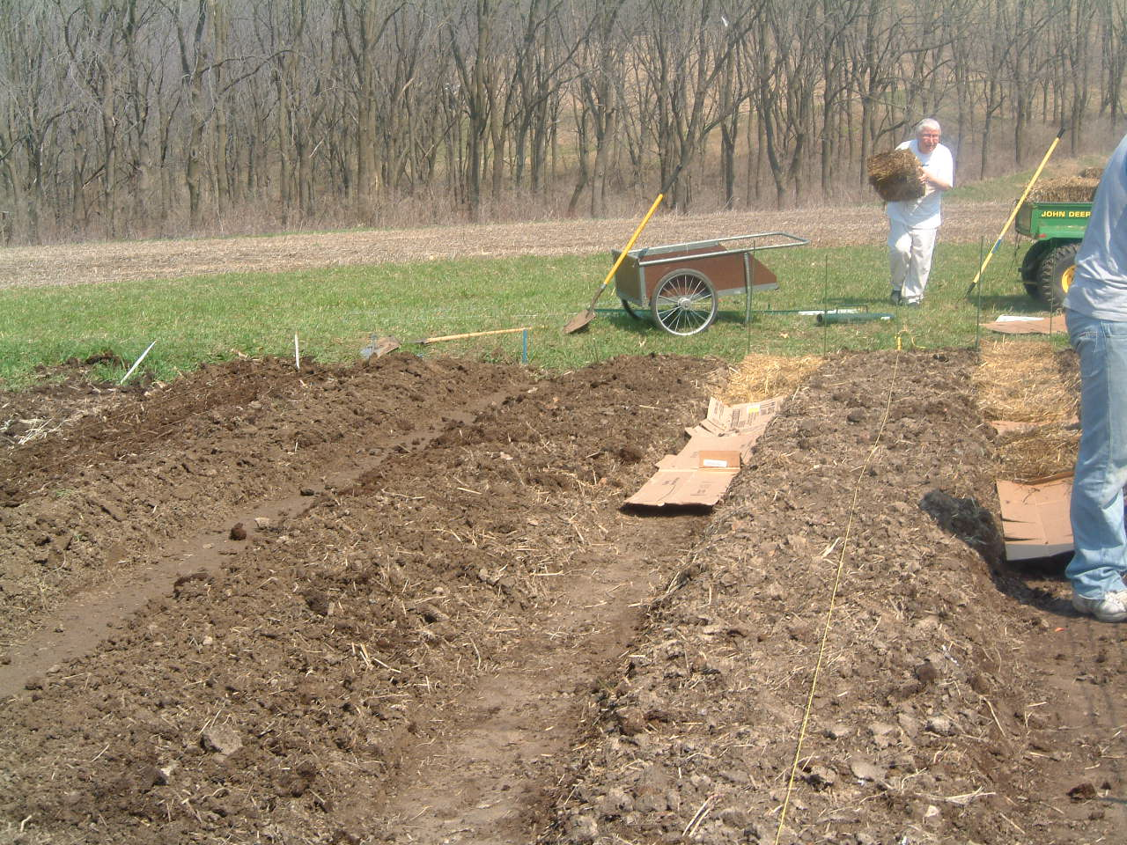
Mulching Walkways
36 inches
18 Inches

Slide 10
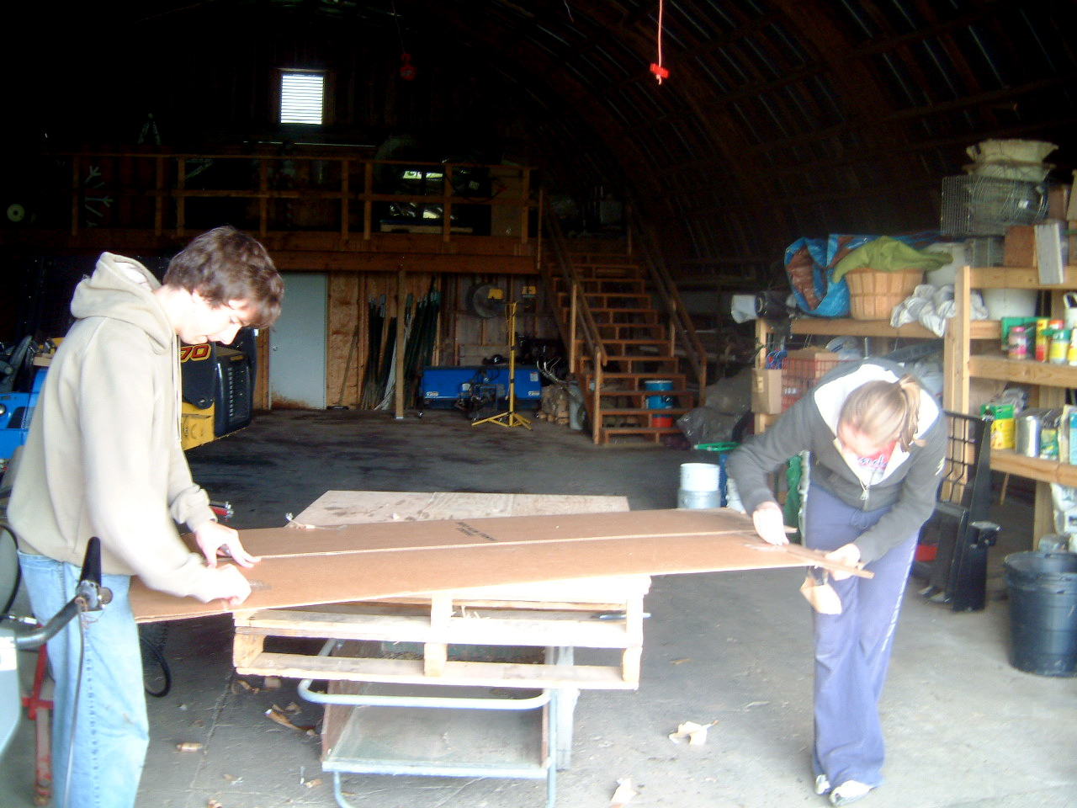
Cardboard
From appliance stores
Remove all tape
Secure flat surface for cutting
Use box cutter – new blades

Slide 11
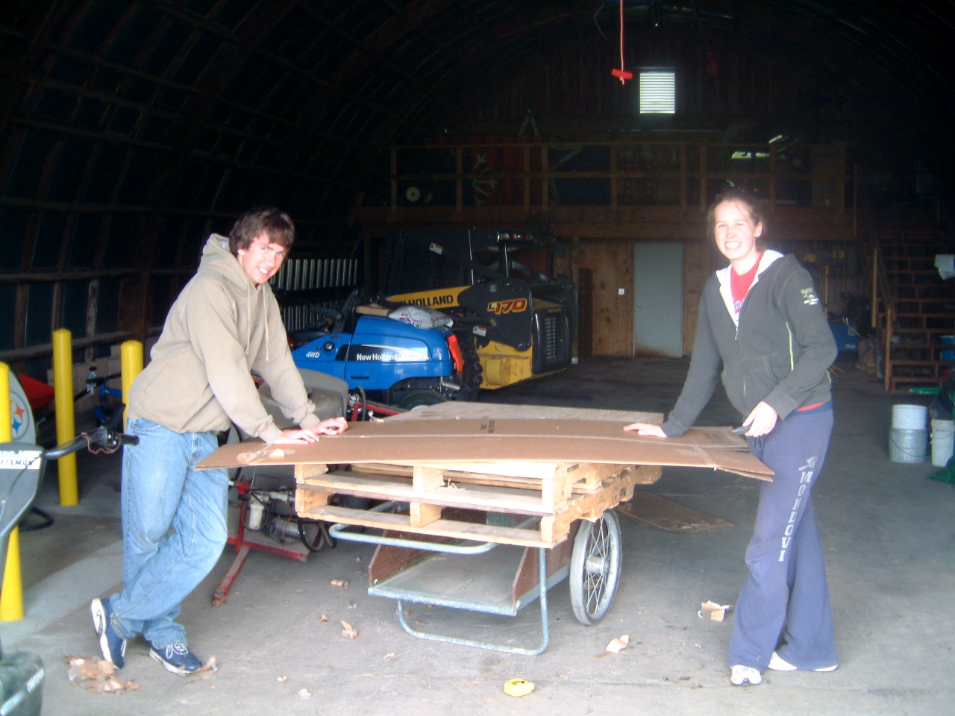

Slide 12
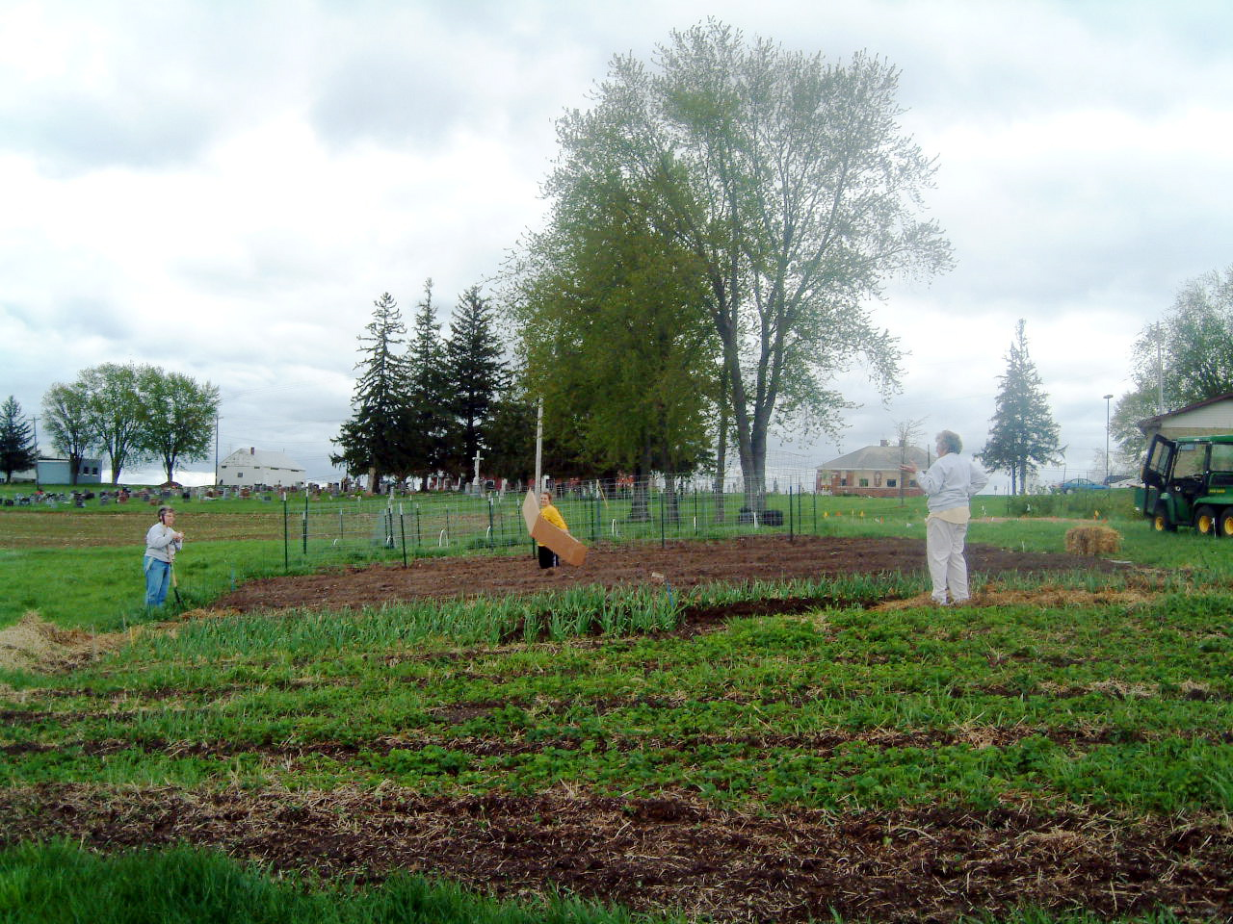

Slide 13
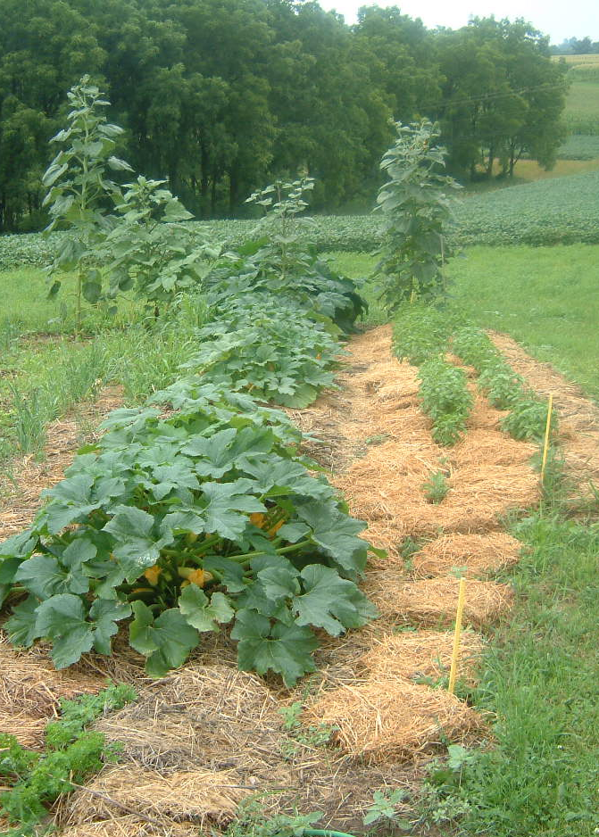
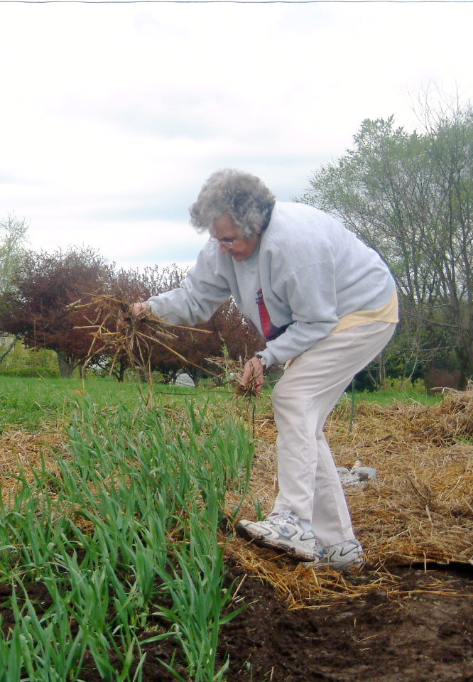

Slide 14
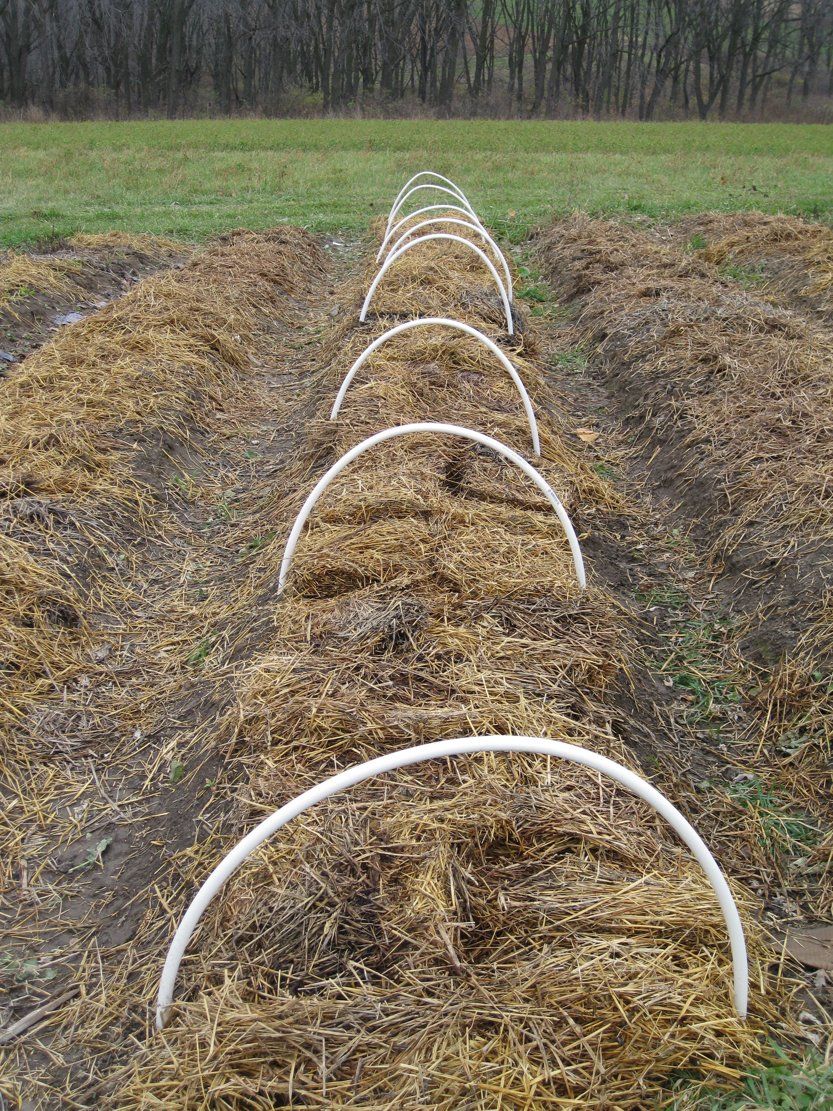
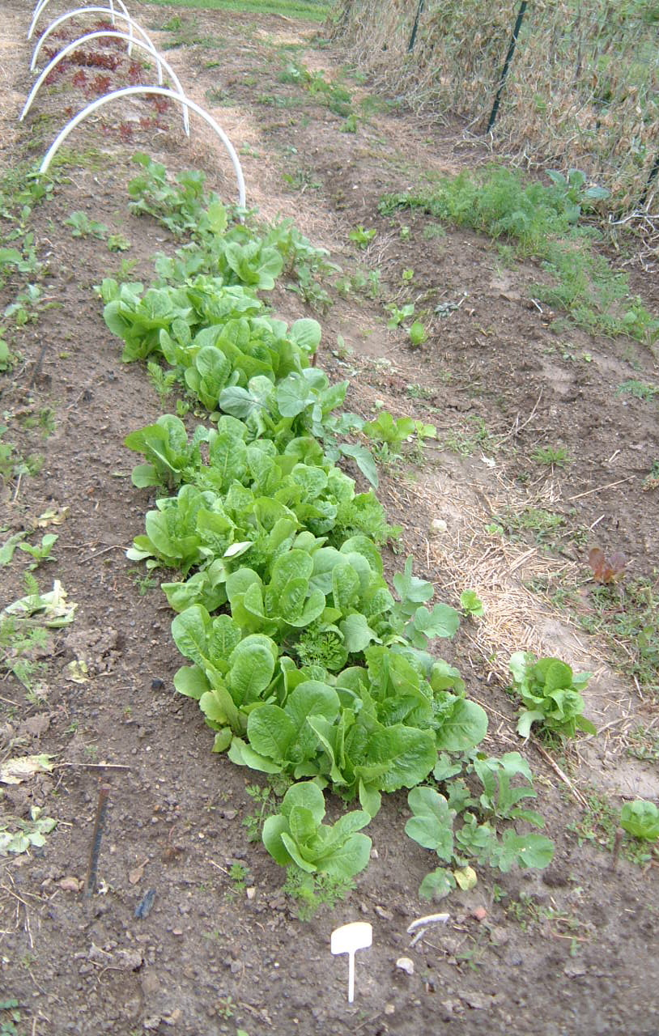
Fall Planted Lettuce
Hooped & mulched
Uncovered as soon as snow is gone
Covered with plastic
Harvesting by early June

Slide 15
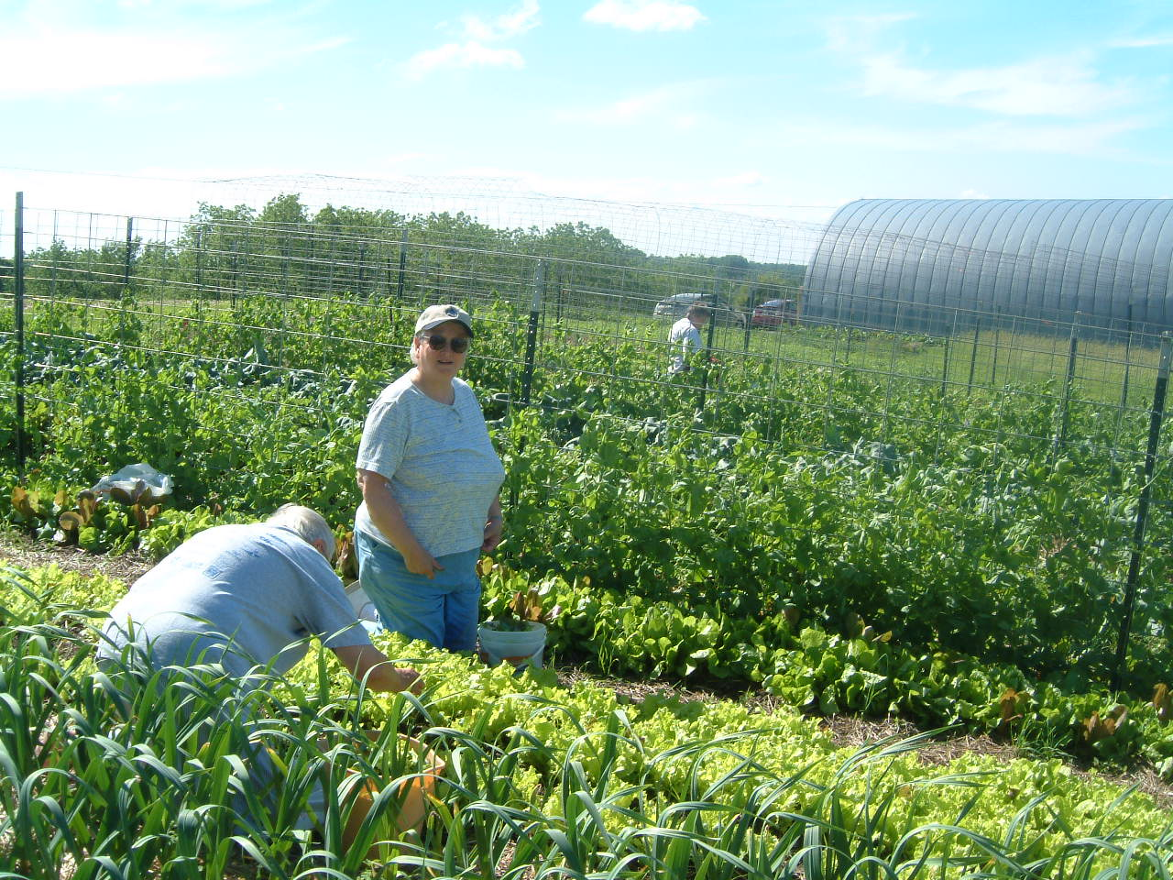

Slide 16
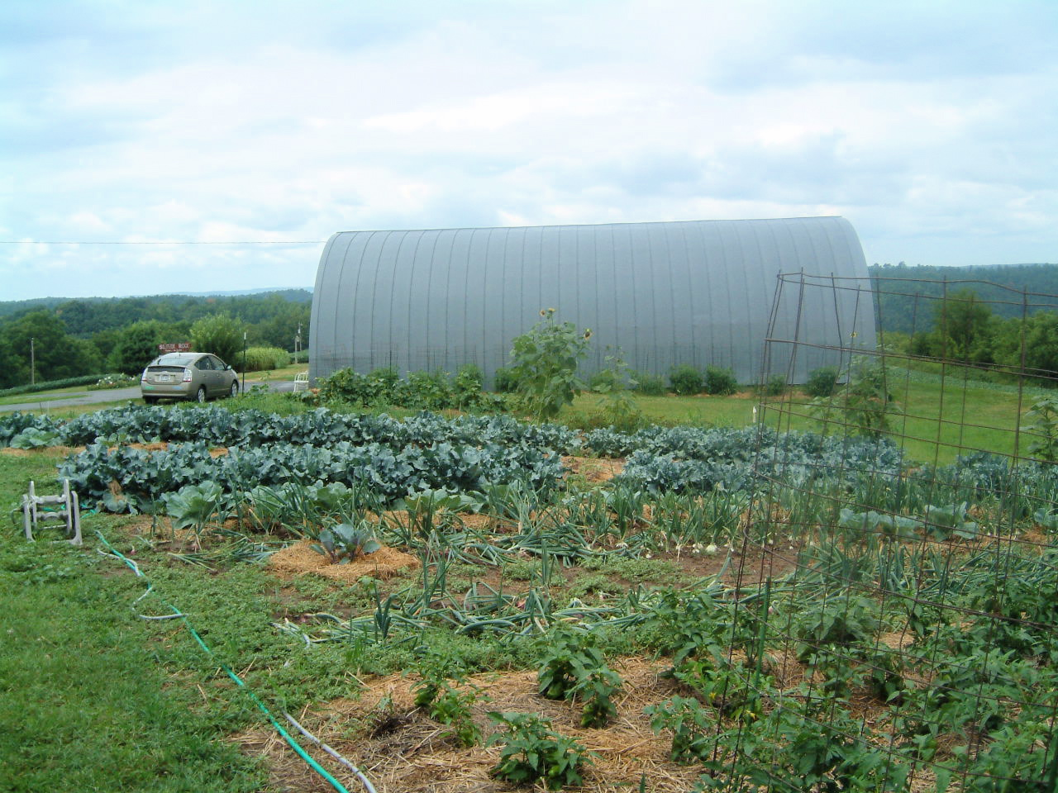
Permaculture
before raised beds

Slide 17
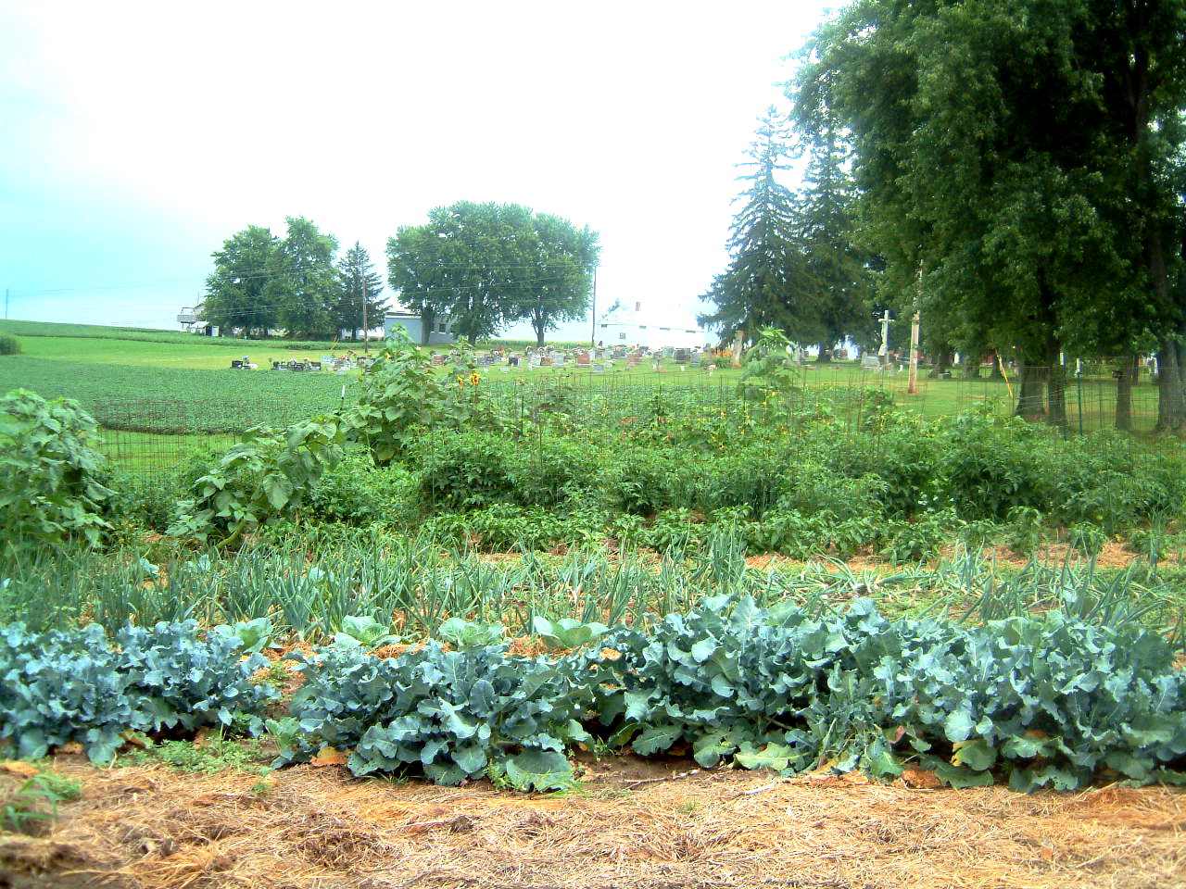

Slide 18
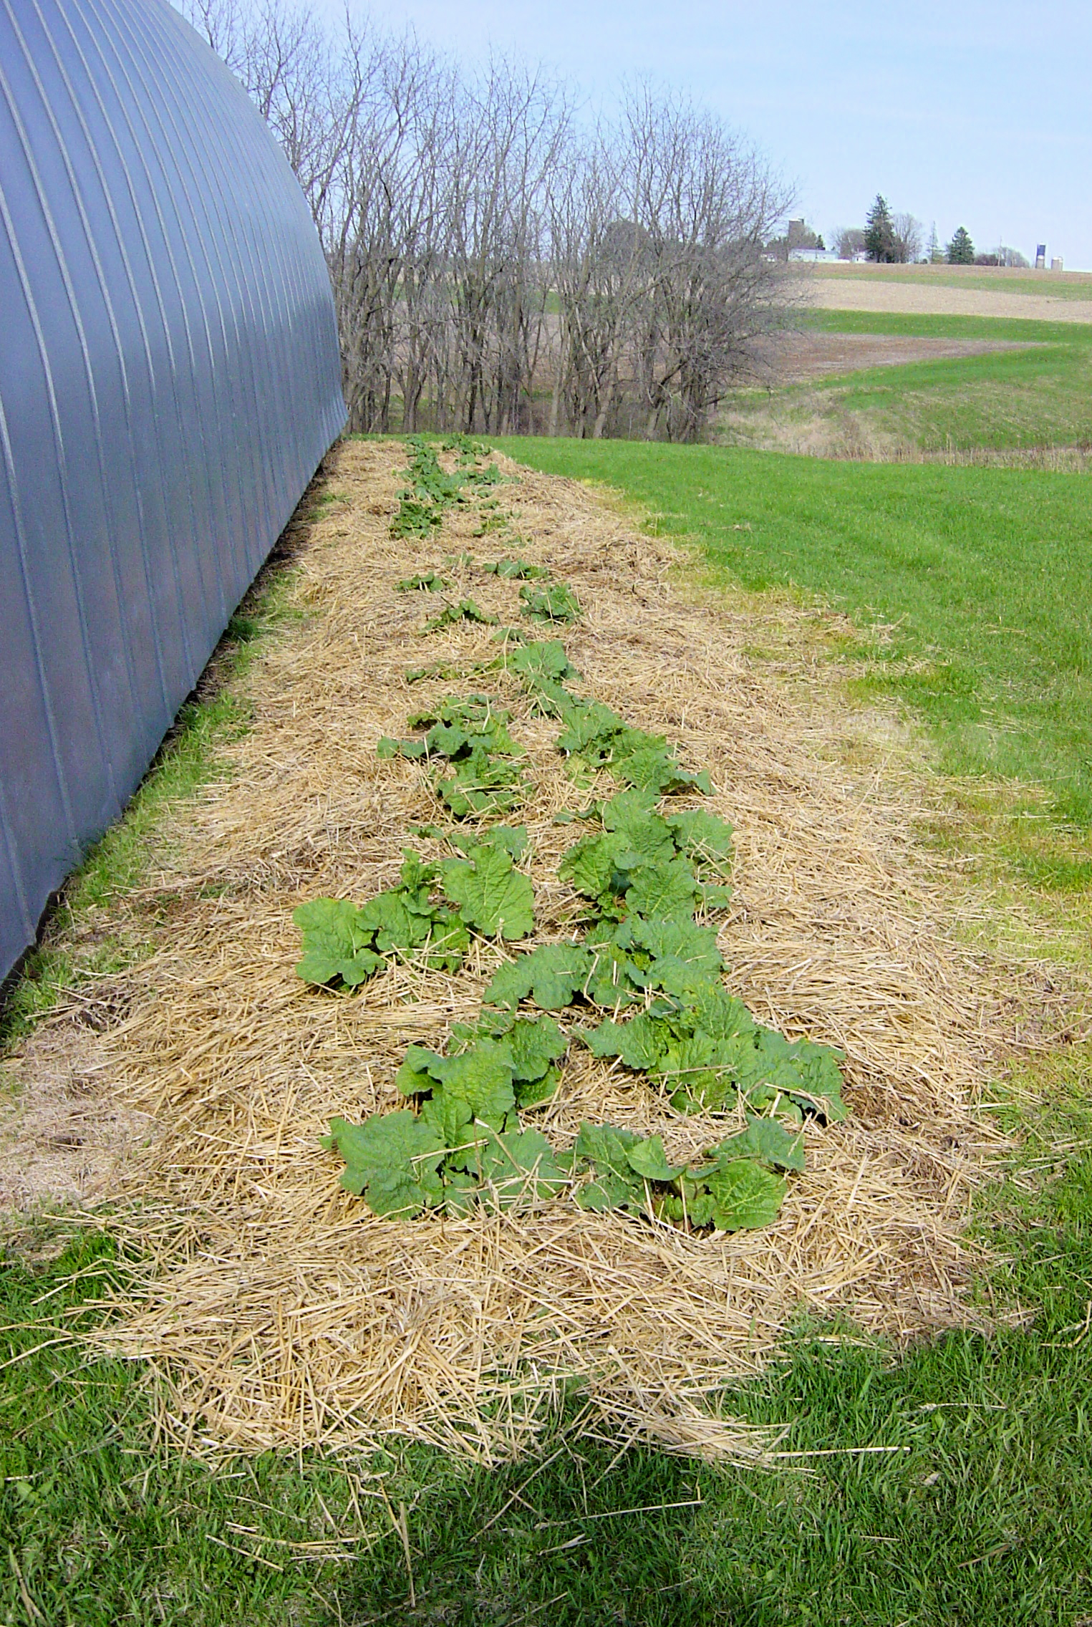
Perennials & never weeding
By thick straw/hay mulch

Slide 19
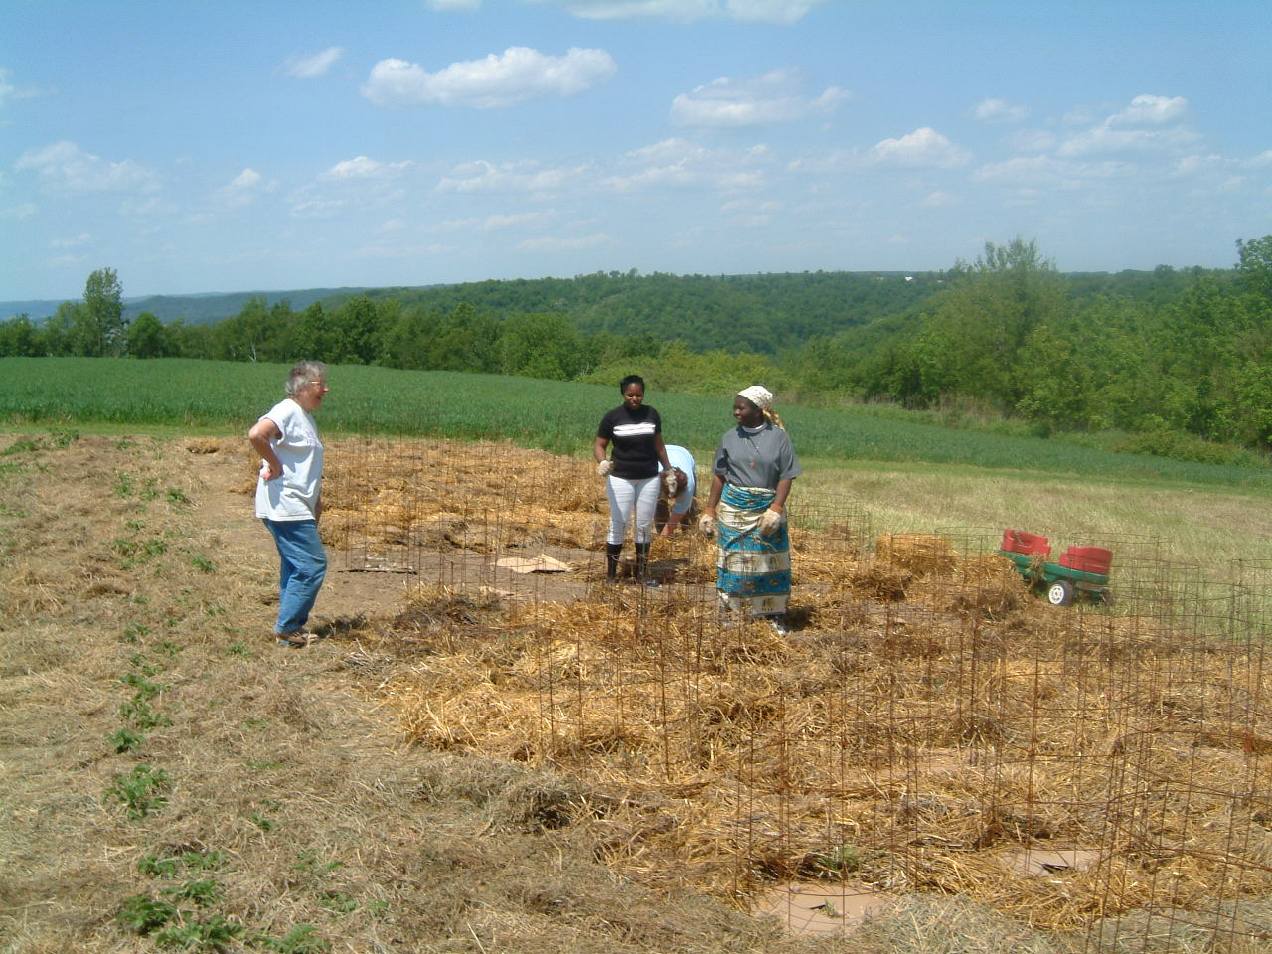
1 X Weeding
Potatoes Tomatoes
Permaculture
North Garden soil building

Slide 20
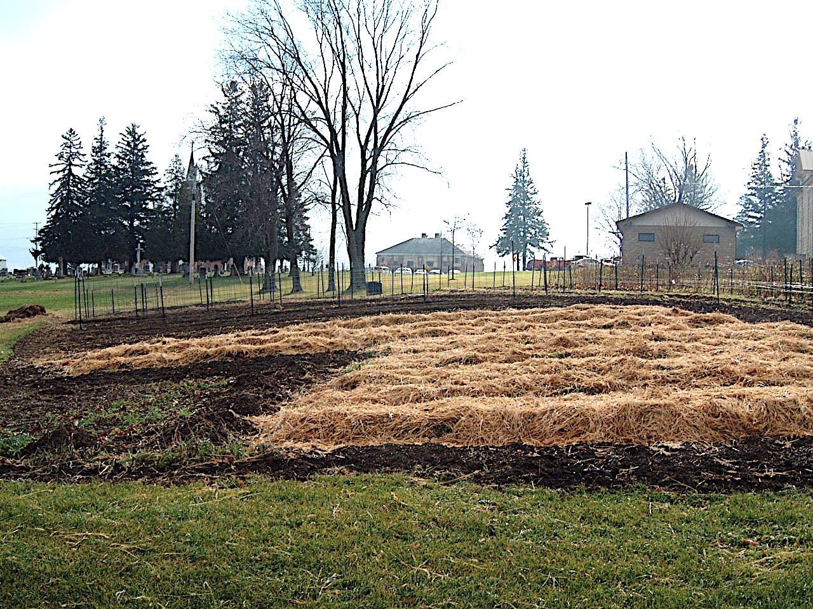
Strawberries thickly blanketed for Winter

Slide 21
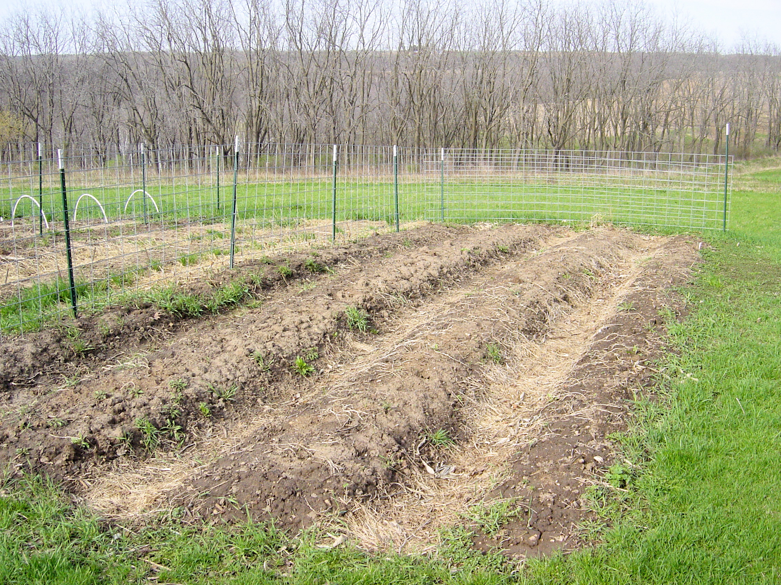
Bare soil areas lightly covered

Slide 22
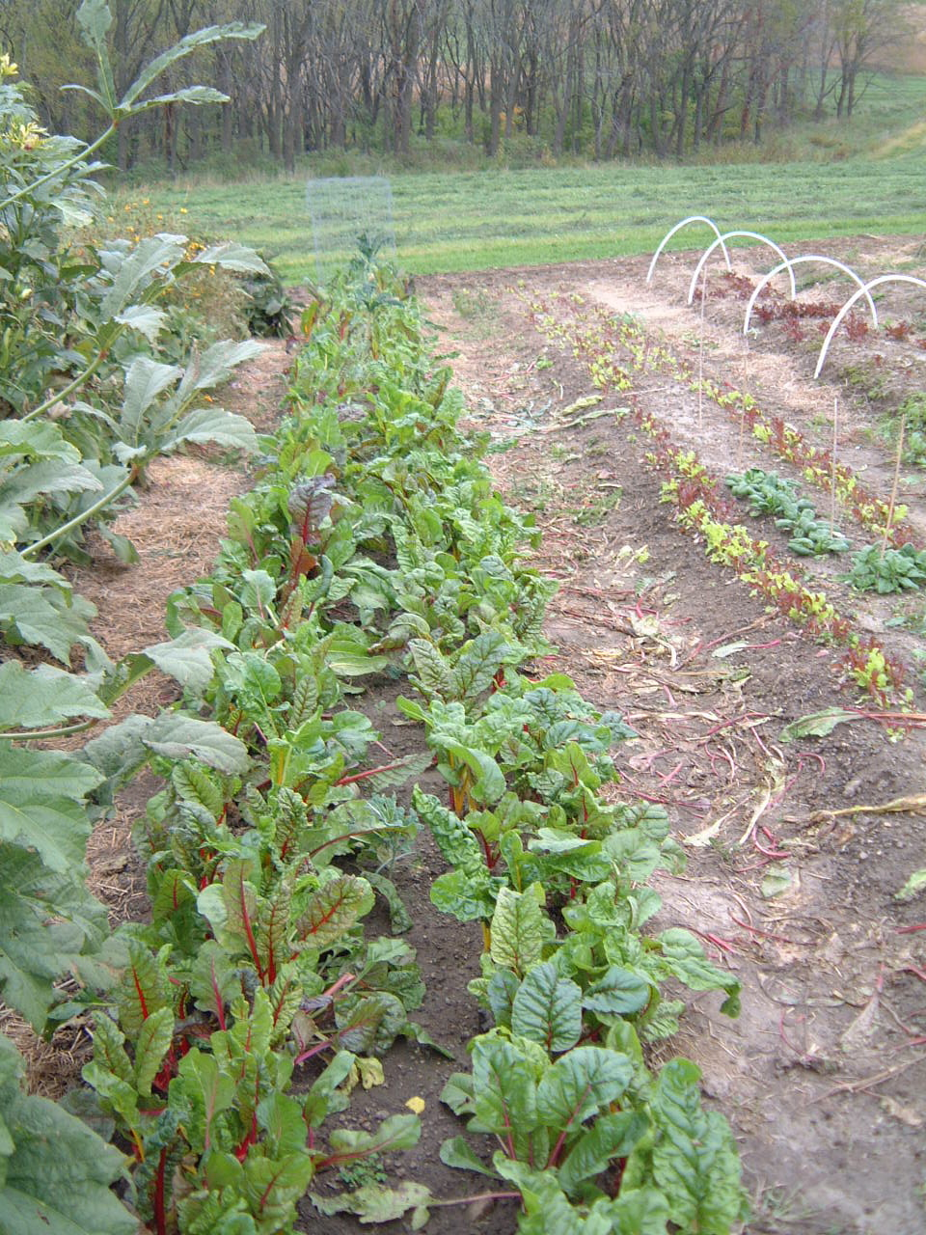
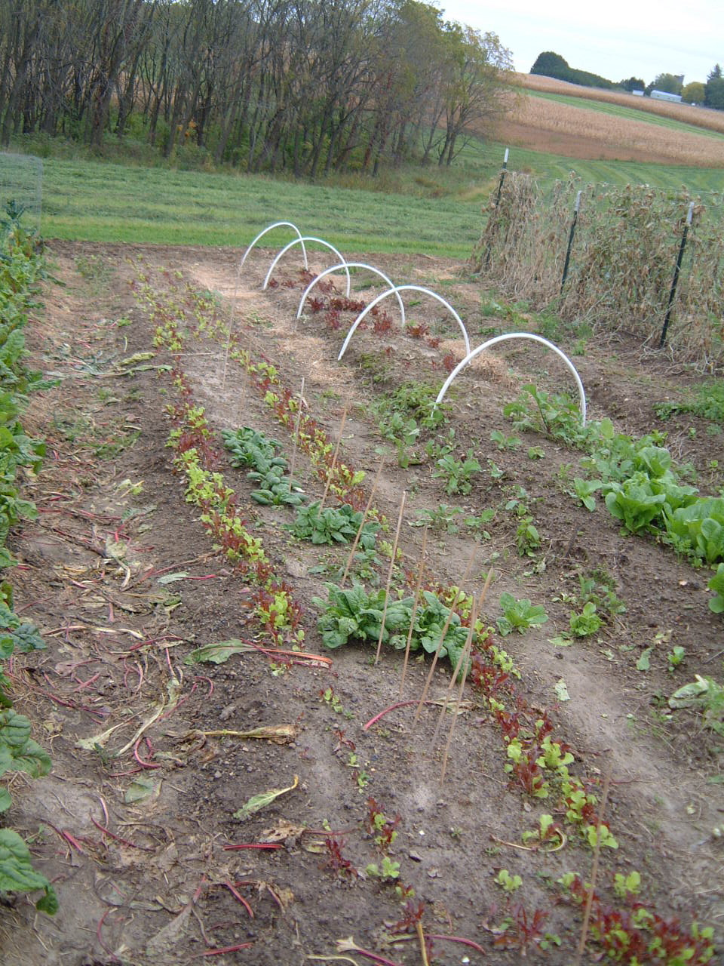
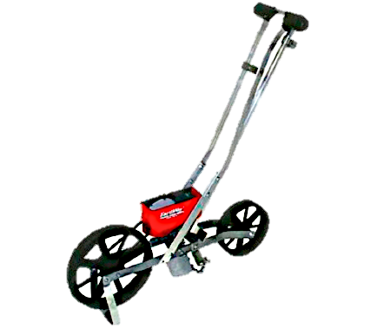
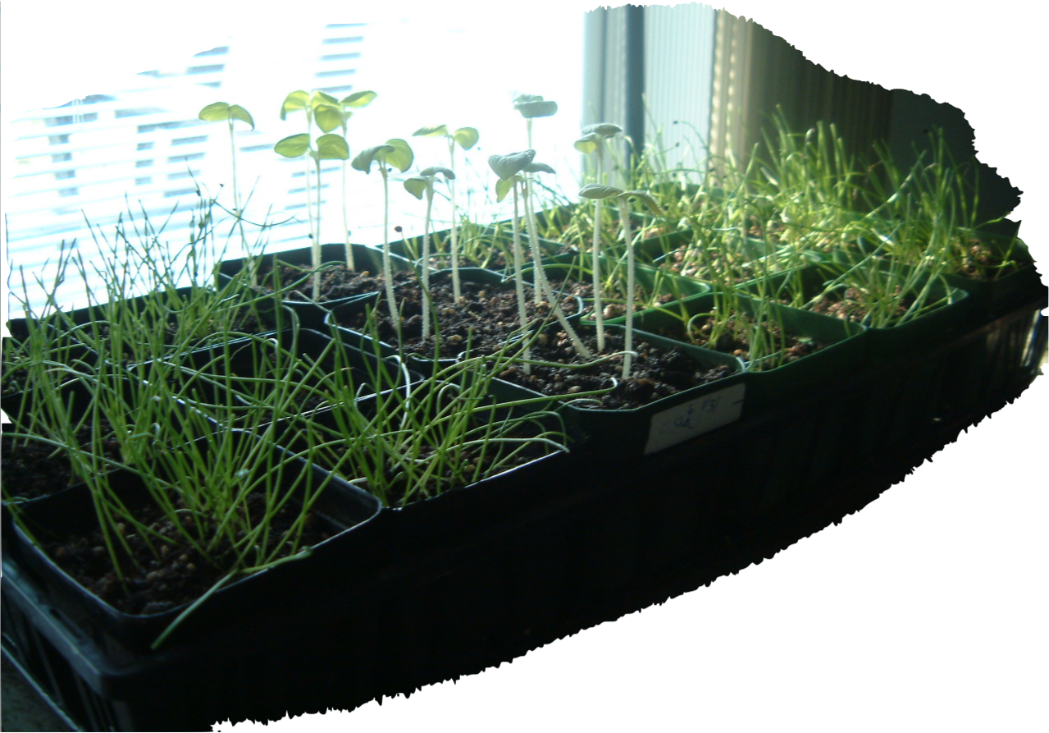
Variety Selection & Seeding
Heirloom & Traditional varieties – test trials
Own transplants – save own seeds
Earthway Garden Seeder

Slide 23
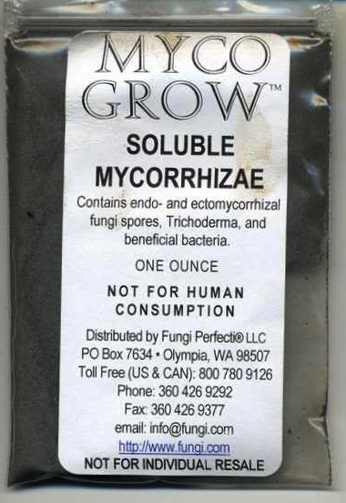
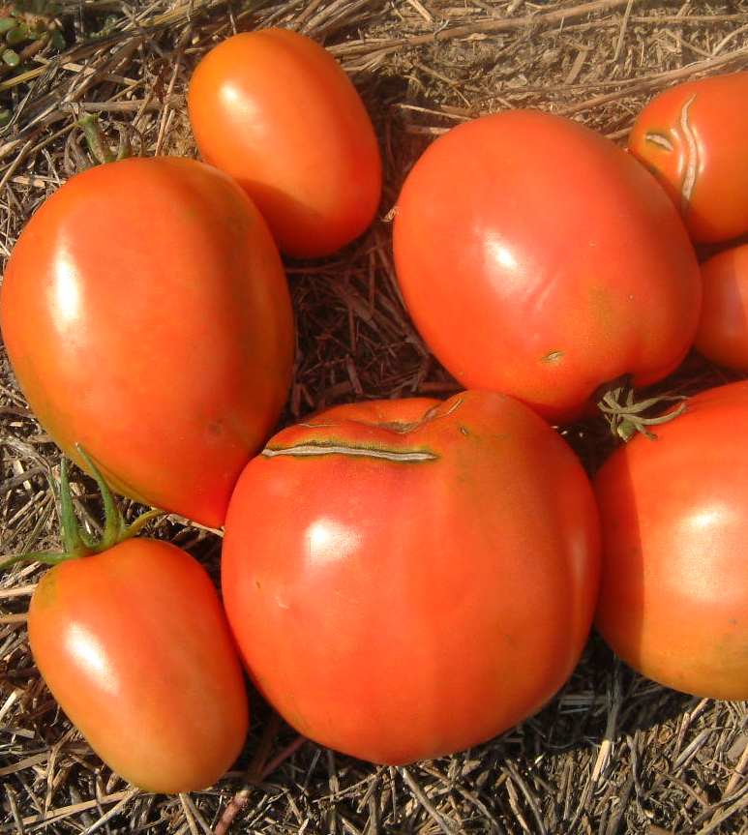
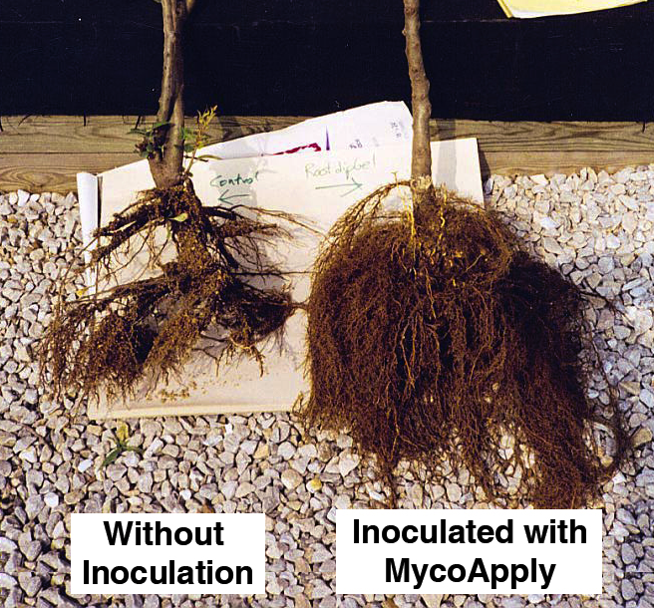
Mychorizal
Inoculant

Slide 24
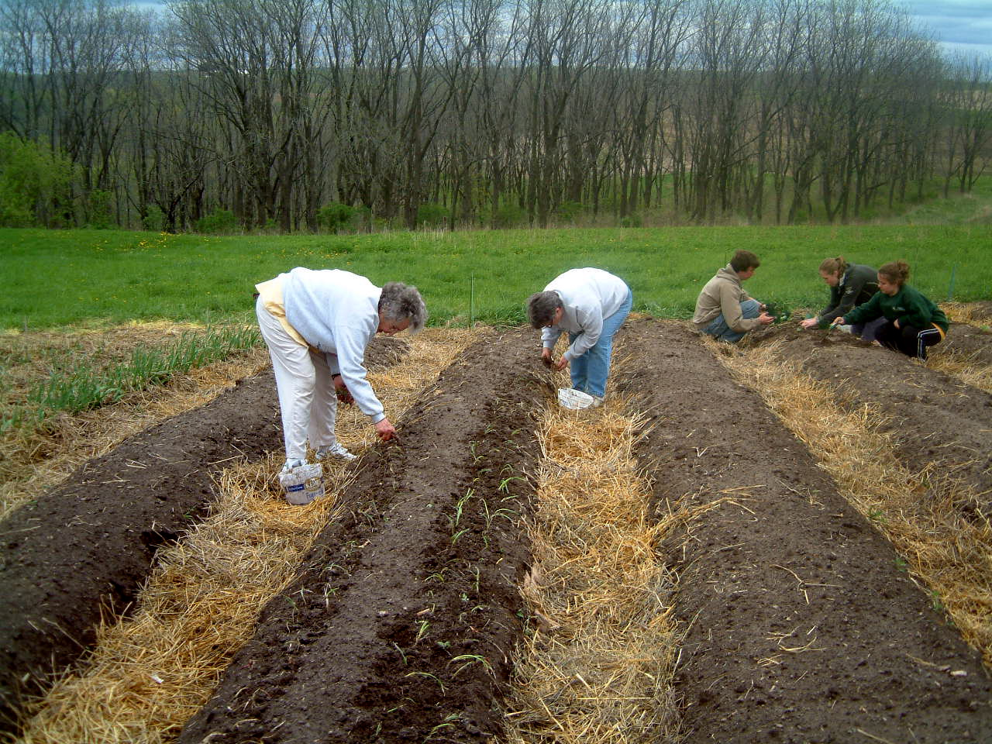
Root dip for transplants
Band Drench or powder seeds

Slide 25
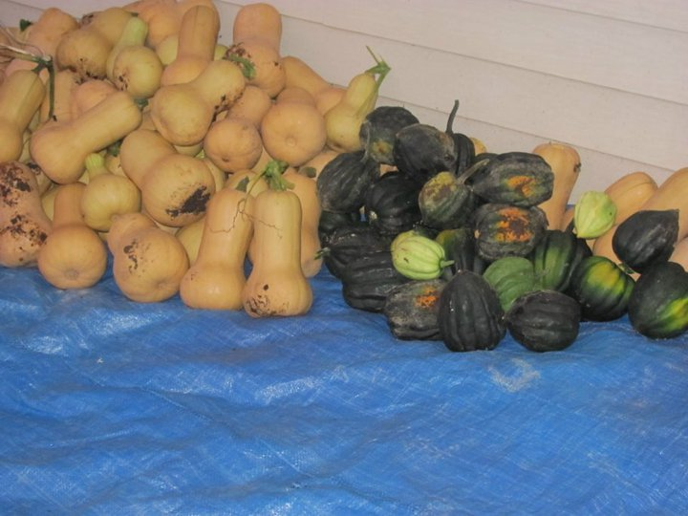
Mychorizal
Advantage
Transplant shock reduction
Size & number of fruit/veggies
Drought, Disease & Pest resistance
Natural part of healthy soils

Slide 26
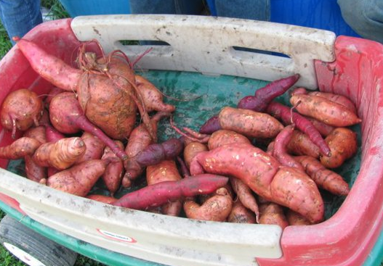
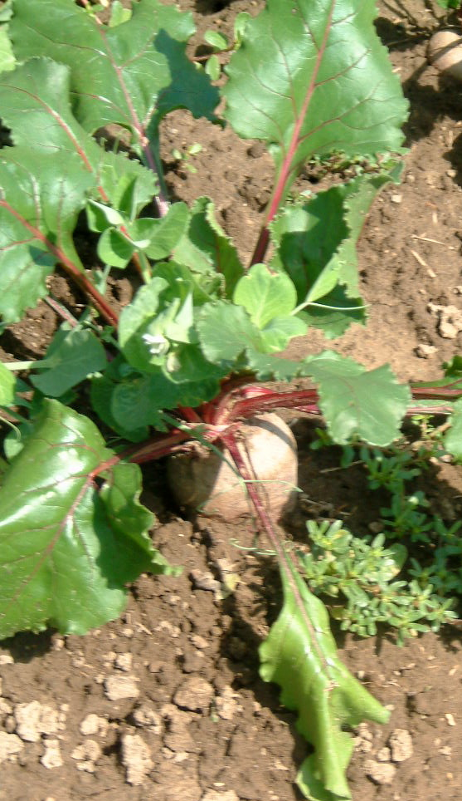
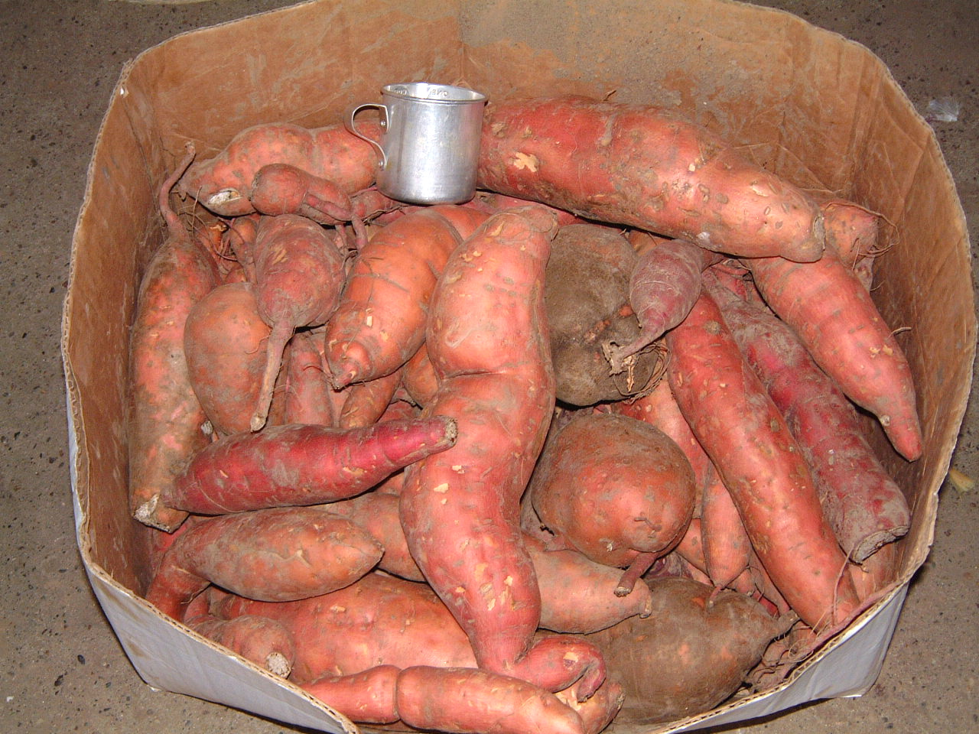

Slide 27
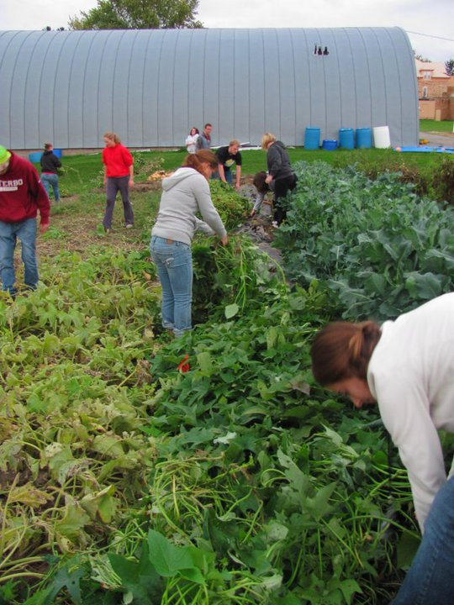
Thick planting
Thick Vegetation
Blocking weeds
Garden
Carts &
Trellises

Slide 28
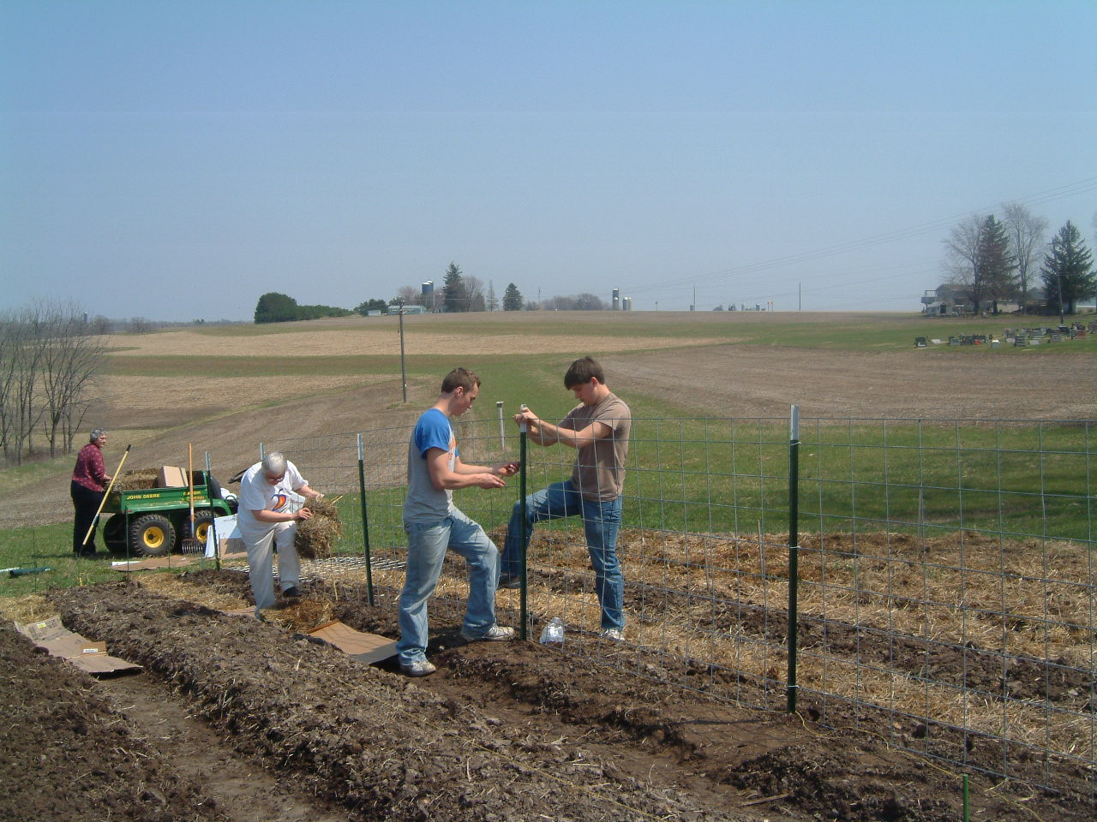
Trellises
Deer deterrents
Harvesting aids
Using cattle panels
Edible pod peas
Pole beans
Cucumbers

Slide 29
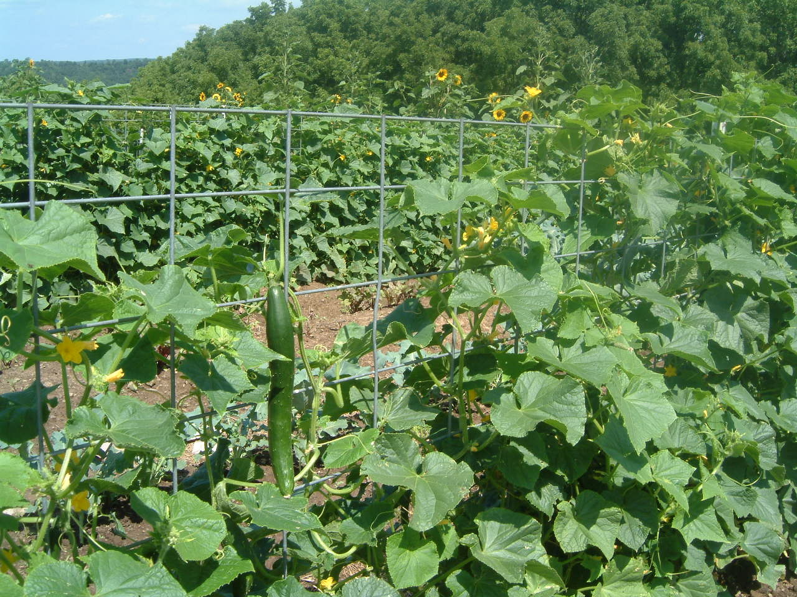

Slide 30
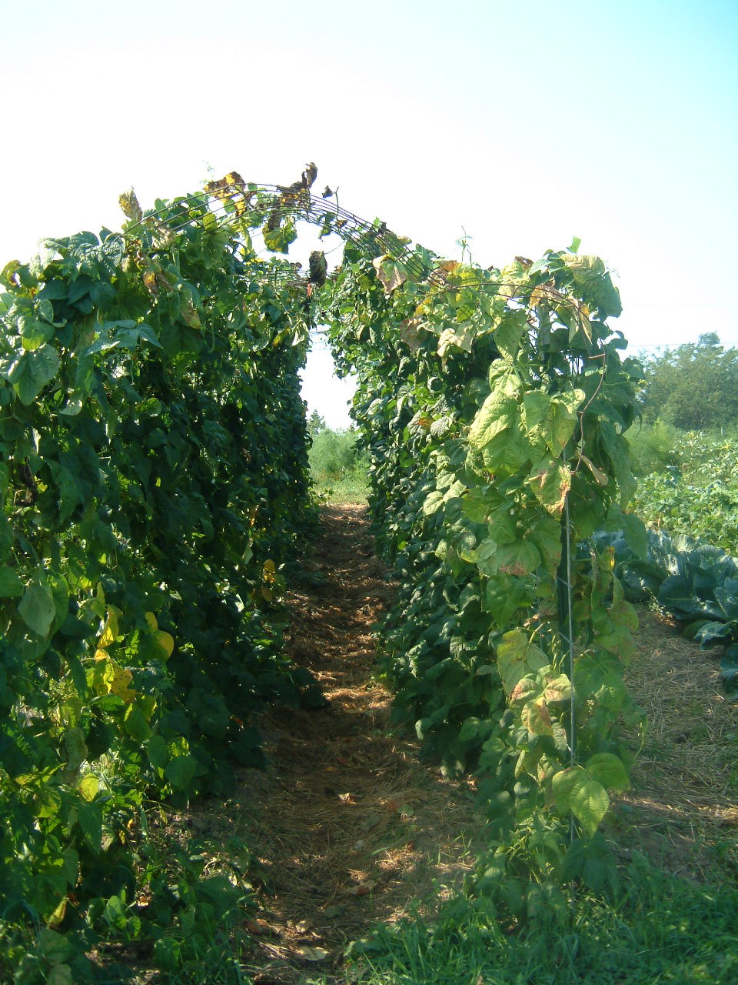
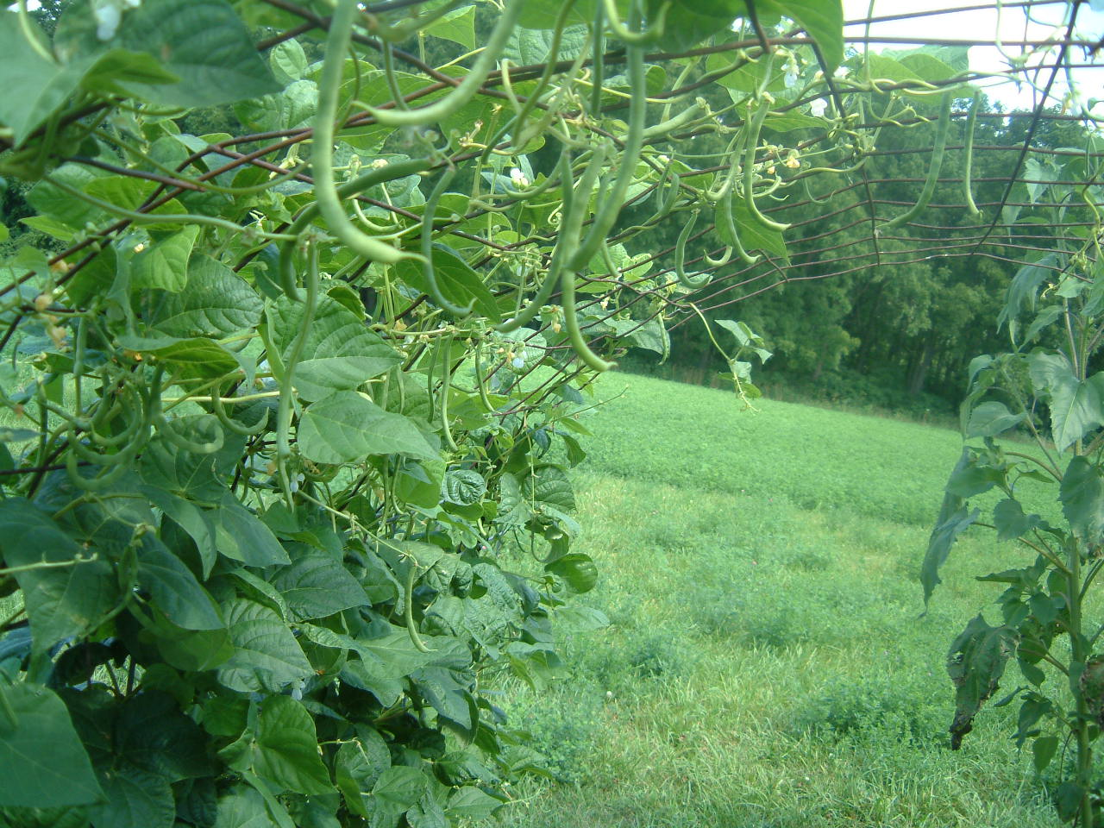

Slide 31
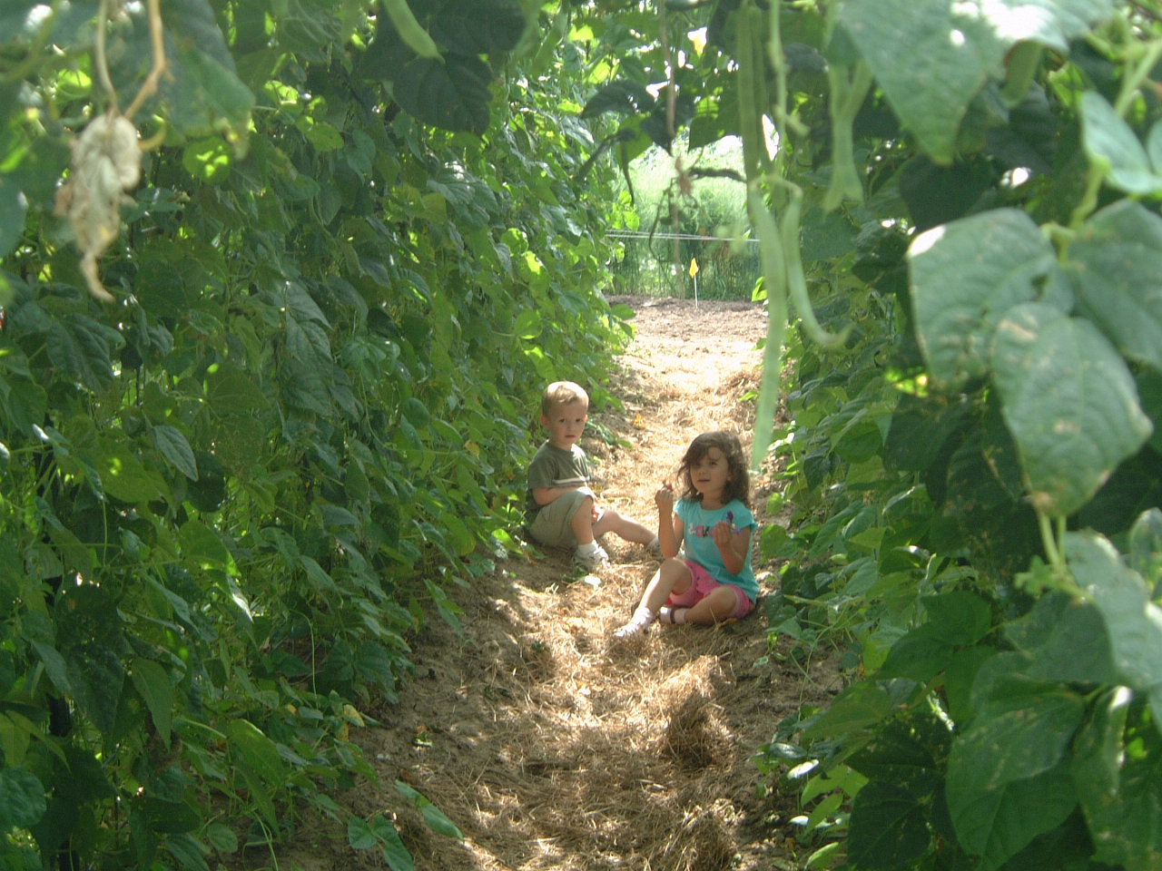

Slide 32
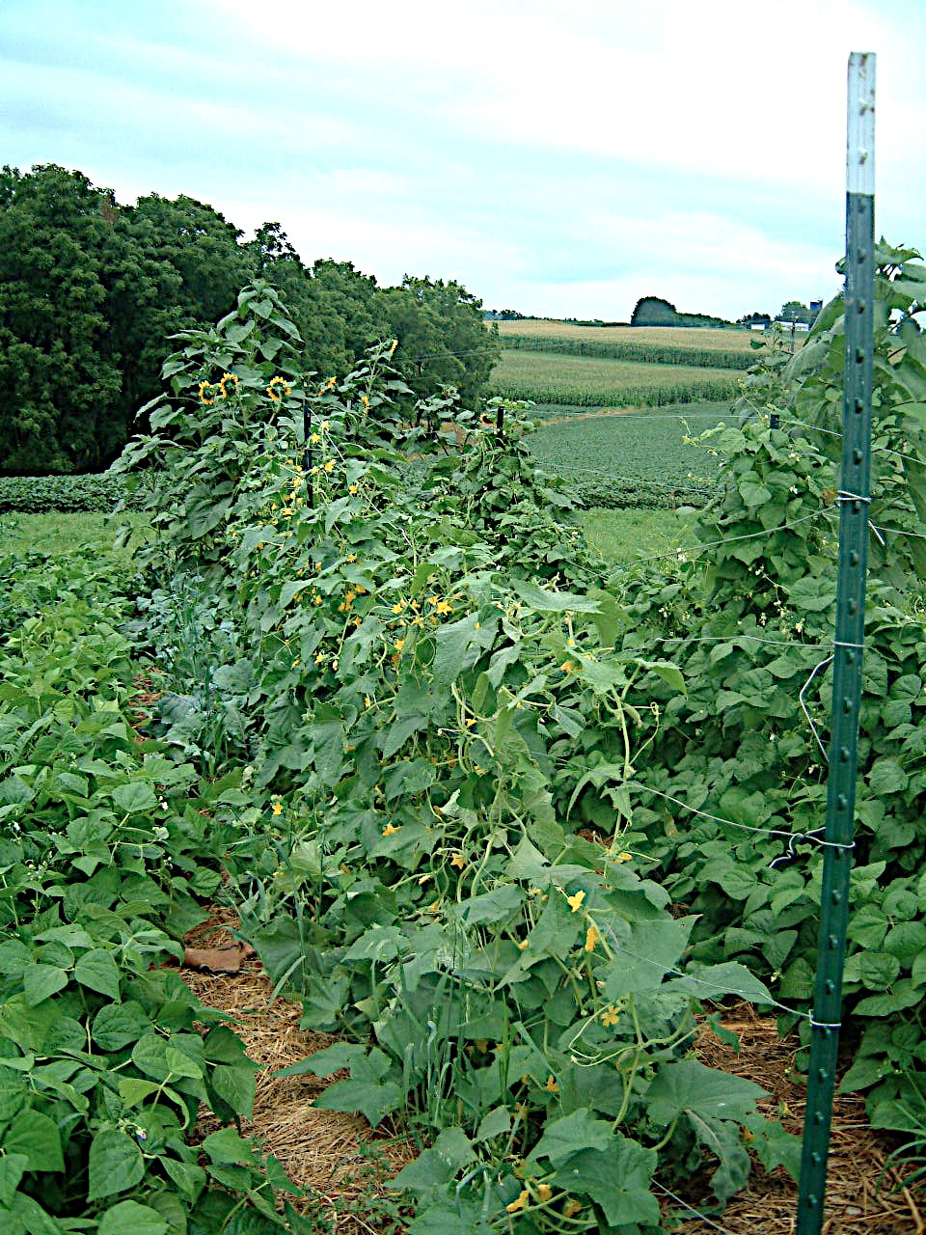
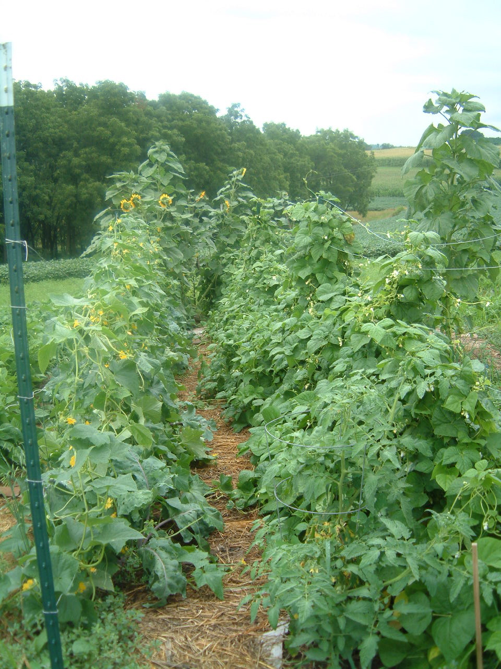

Slide 33
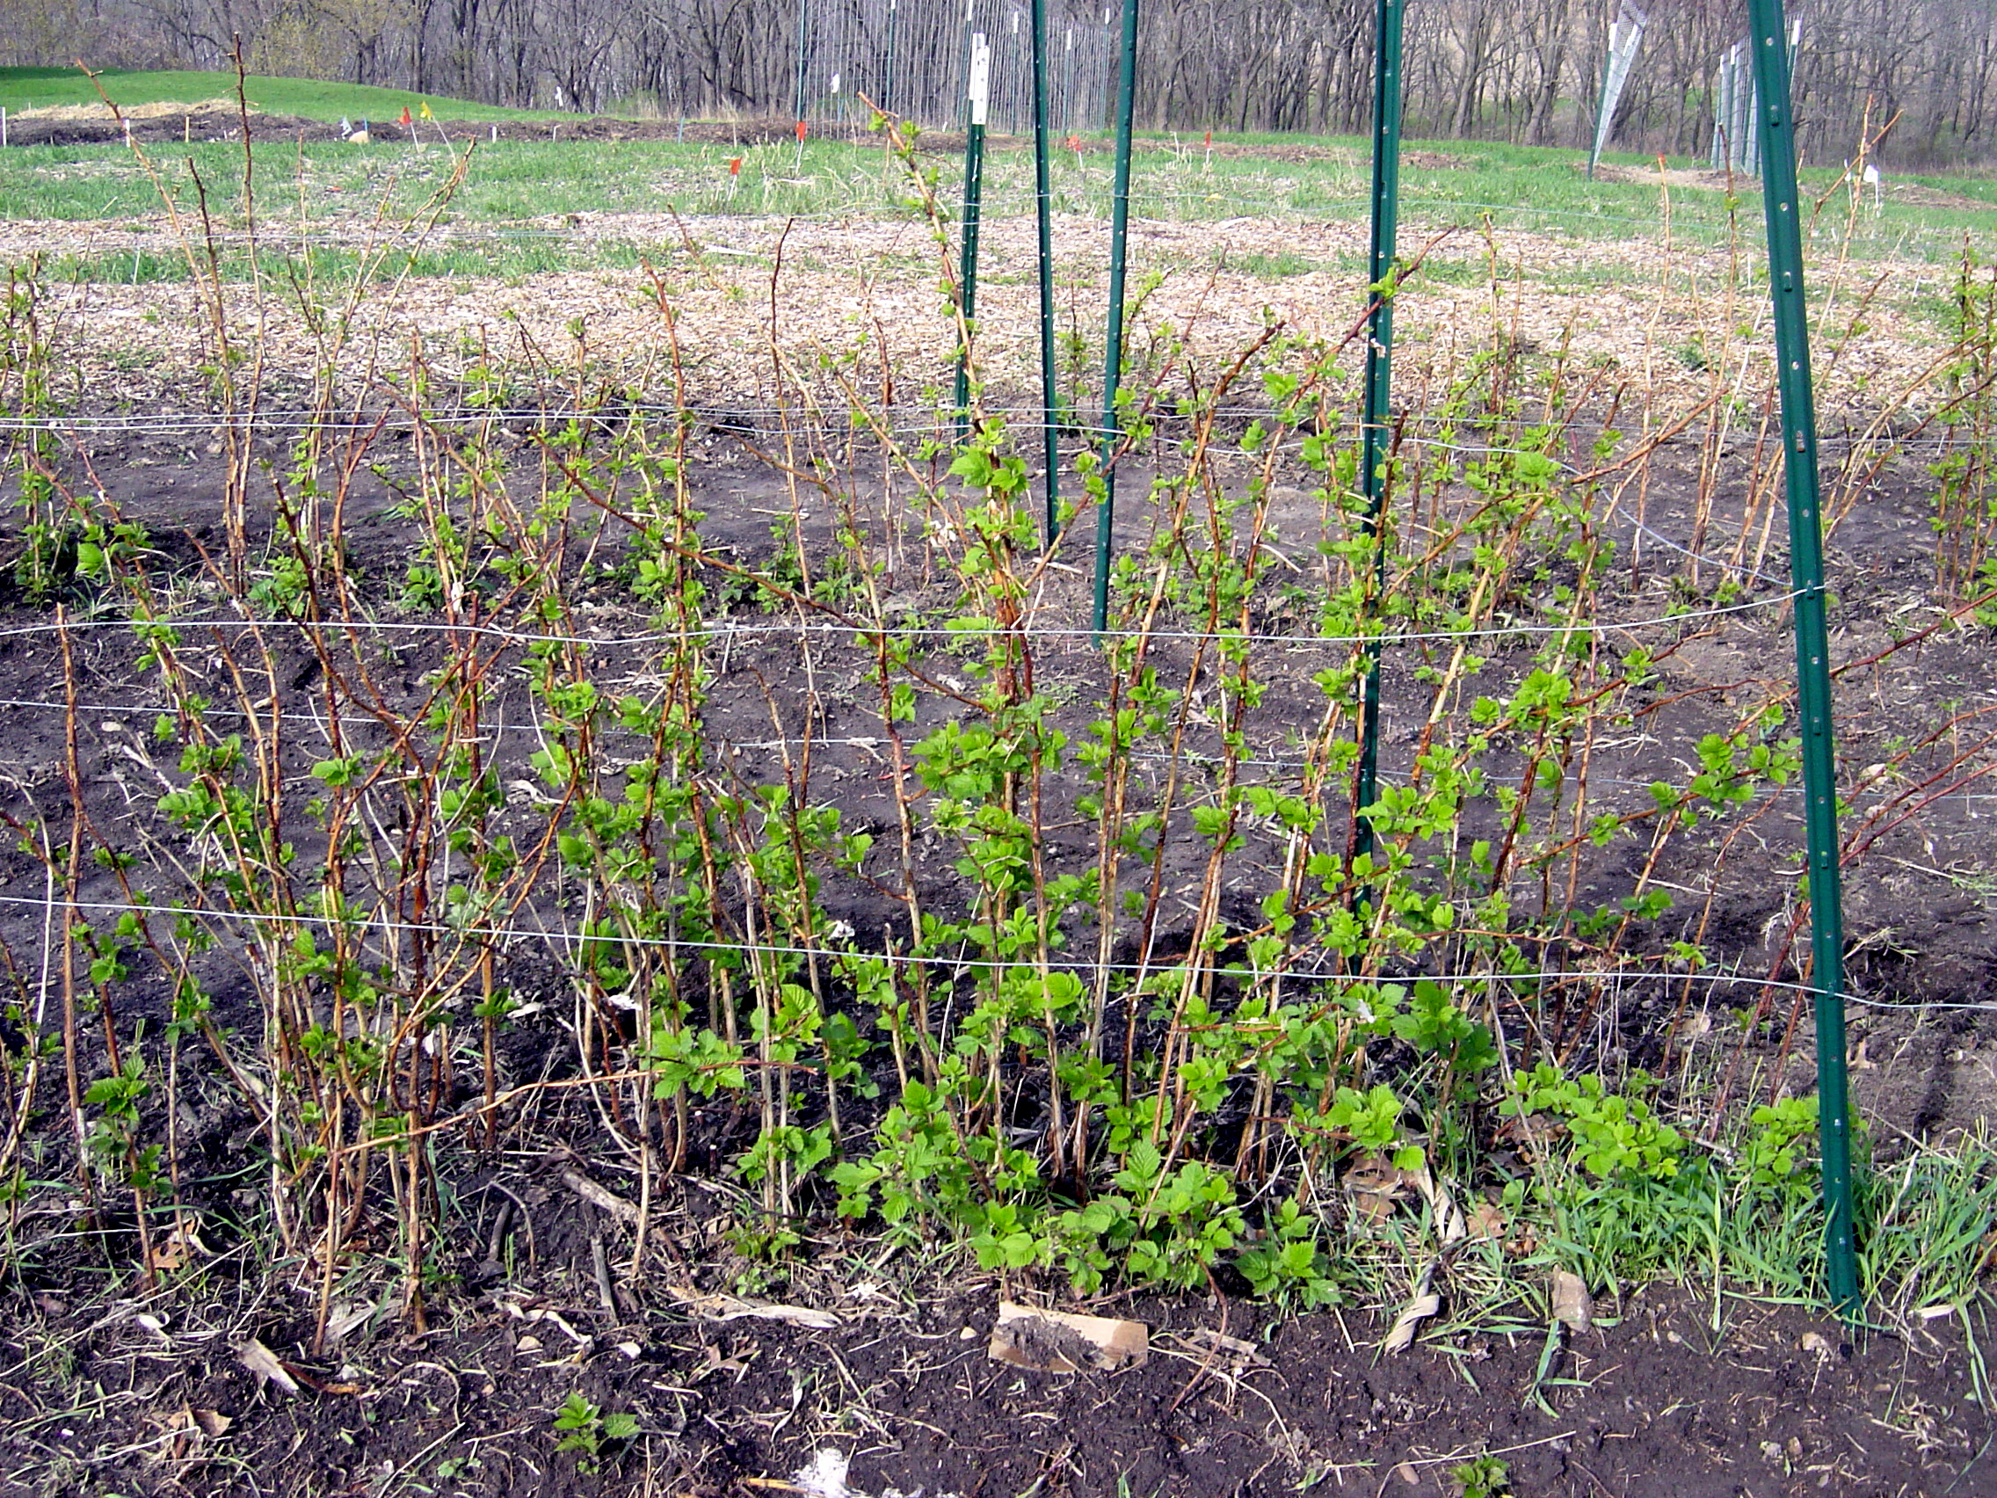
Guide Wires for Raspberries
&
Asparagus

Slide 34
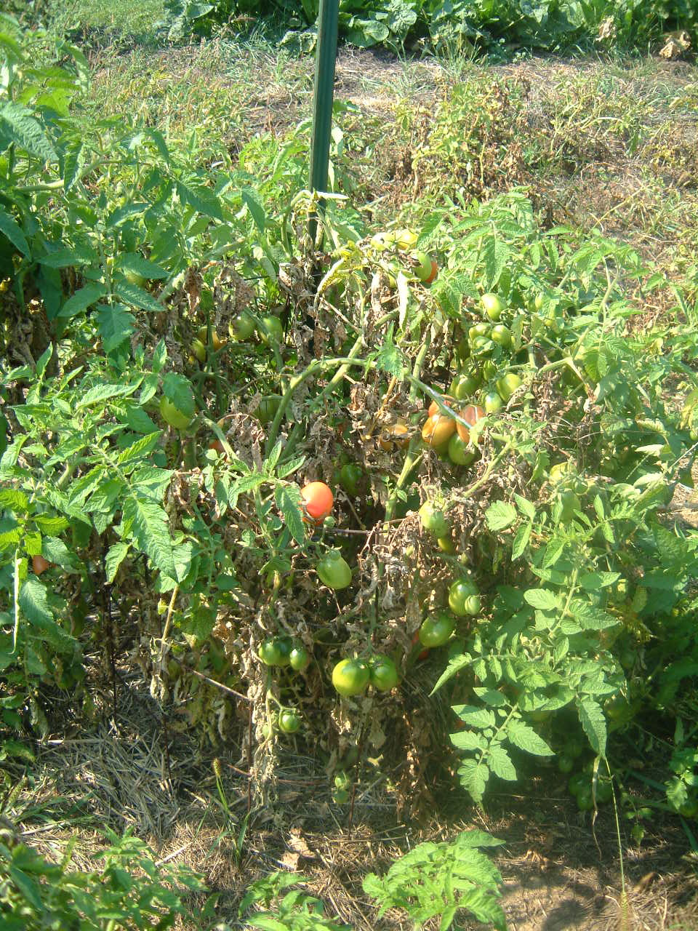
Tomato Hoops
Concrete reinforcement wire
Staked with short garden posts

Slide 35
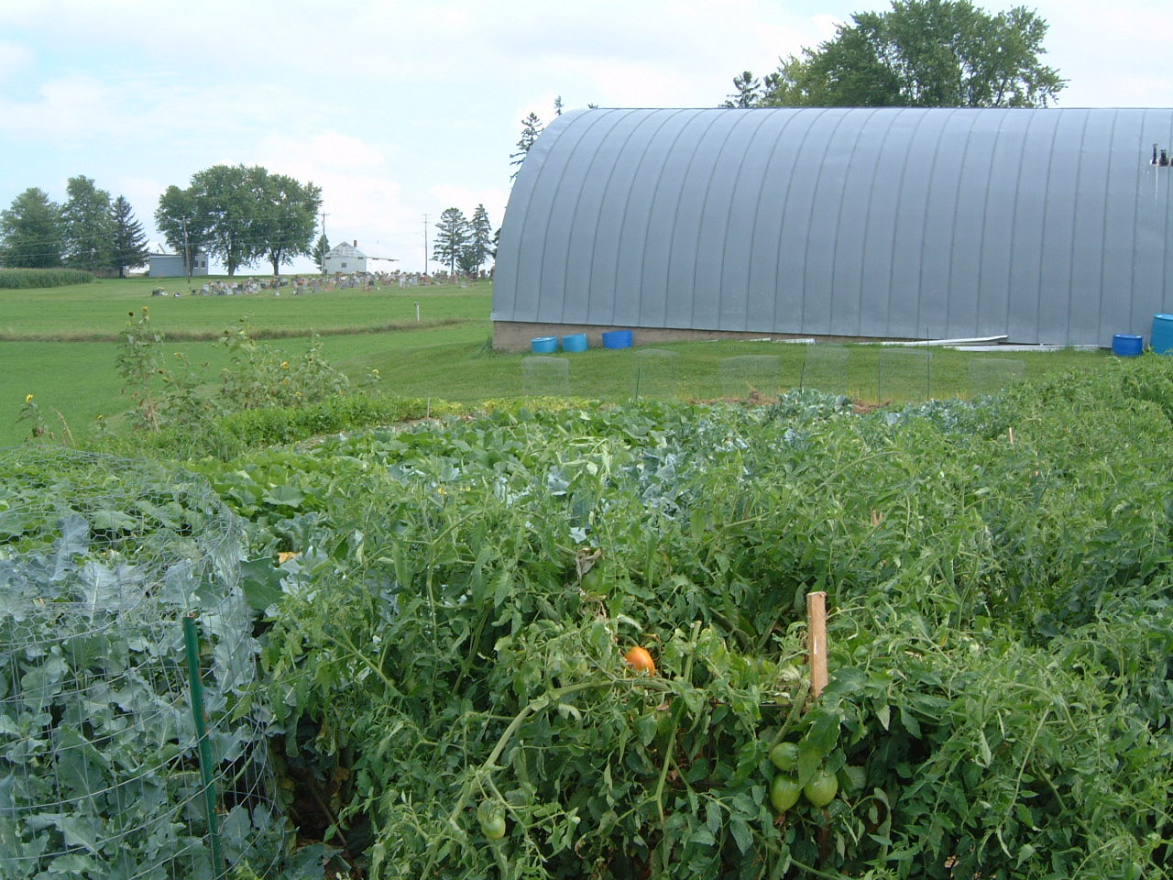

Slide 36
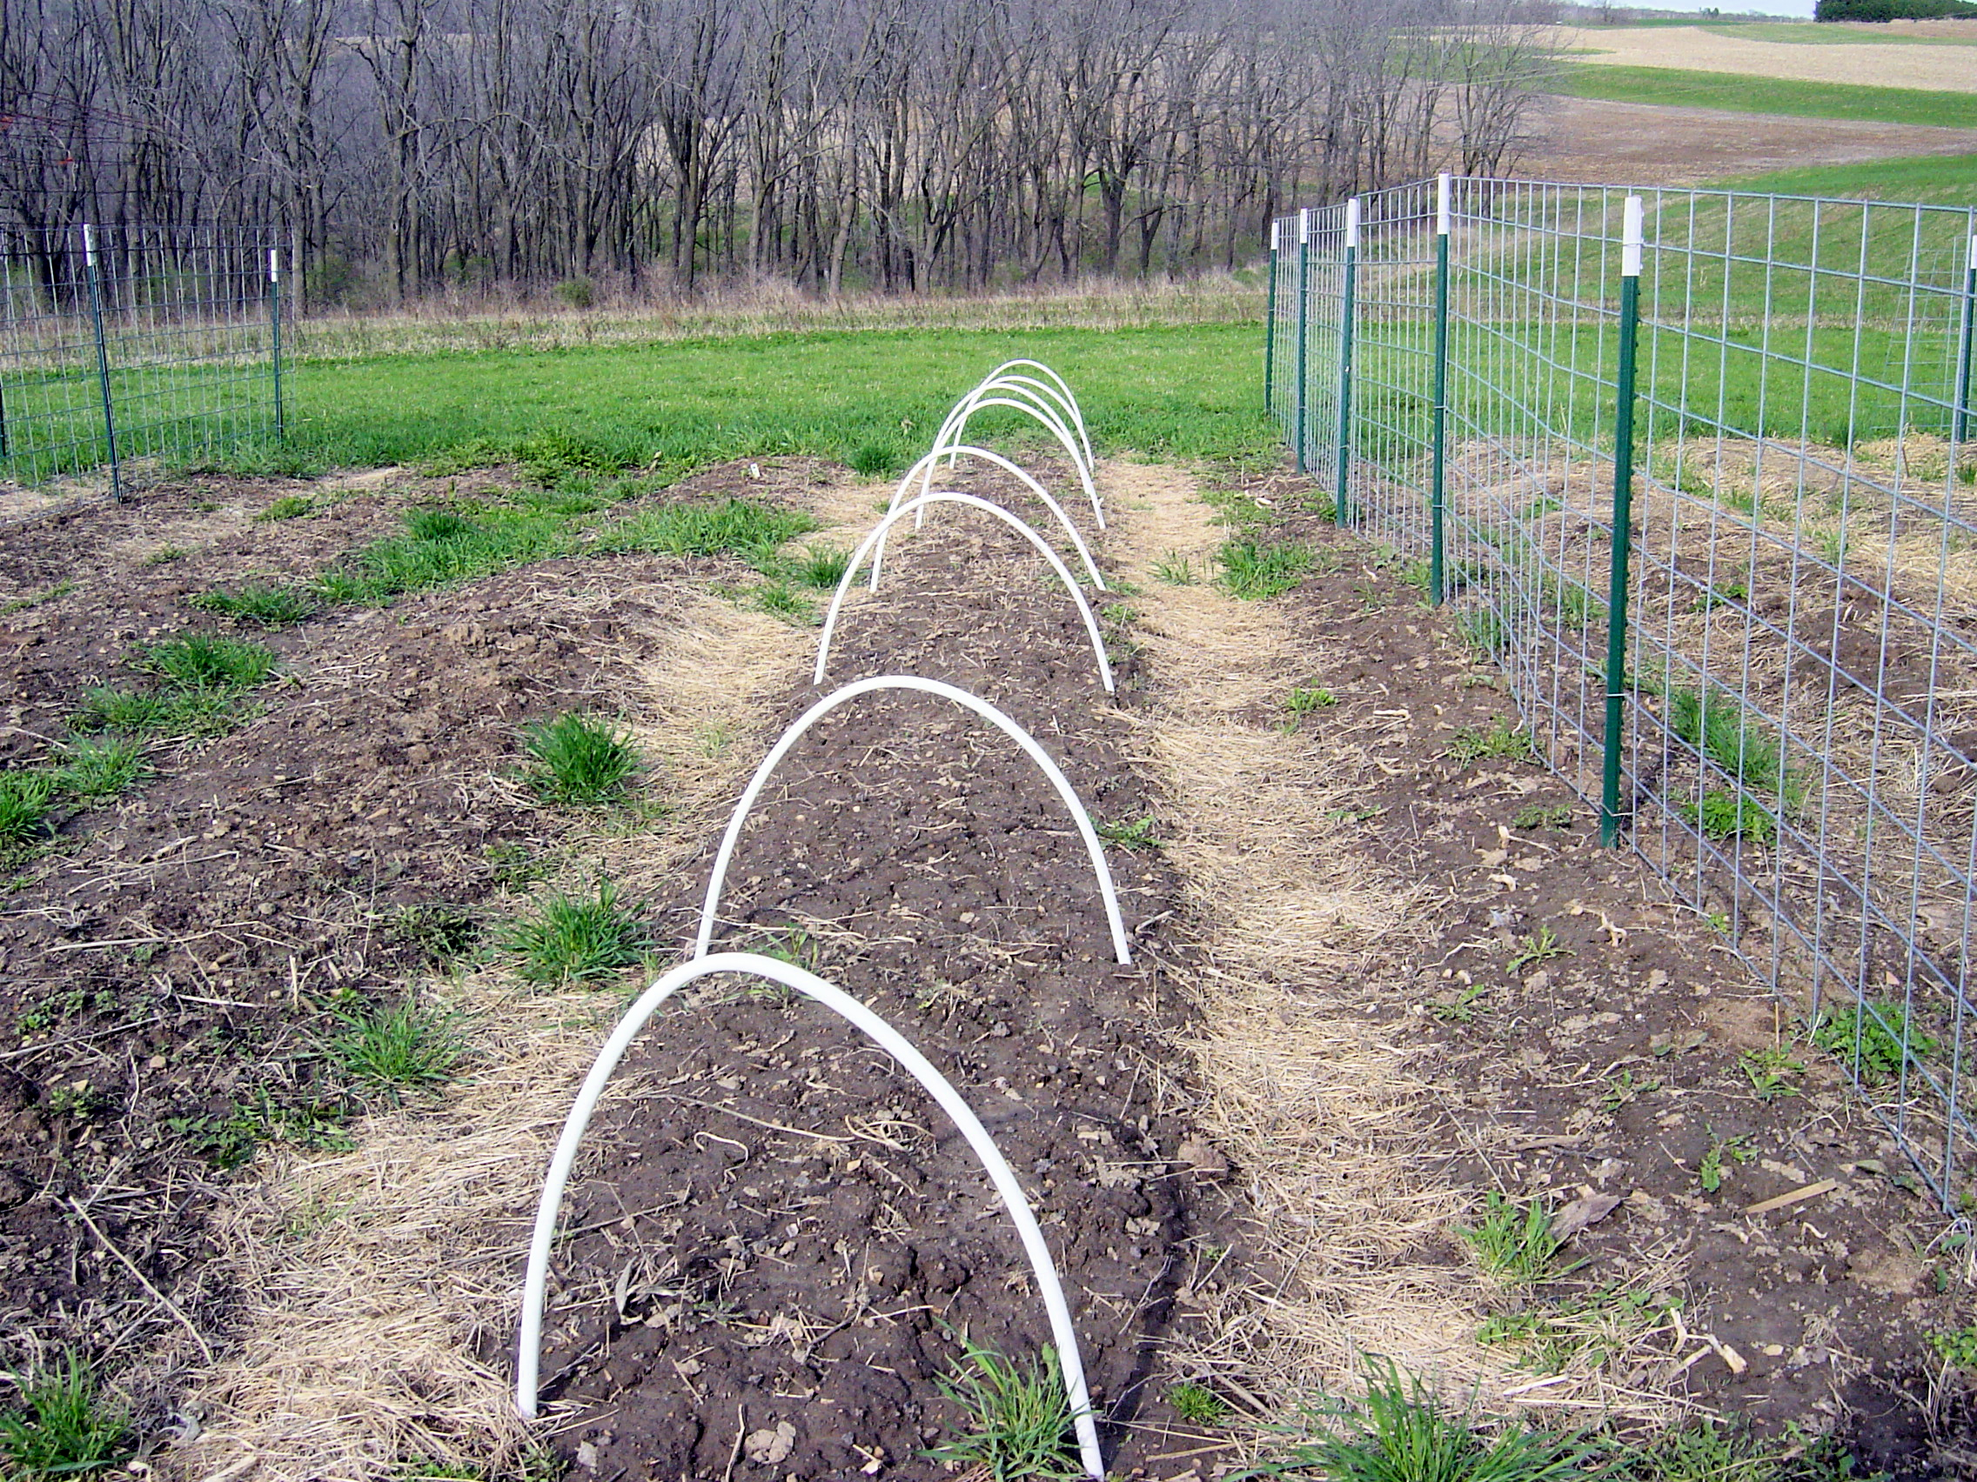
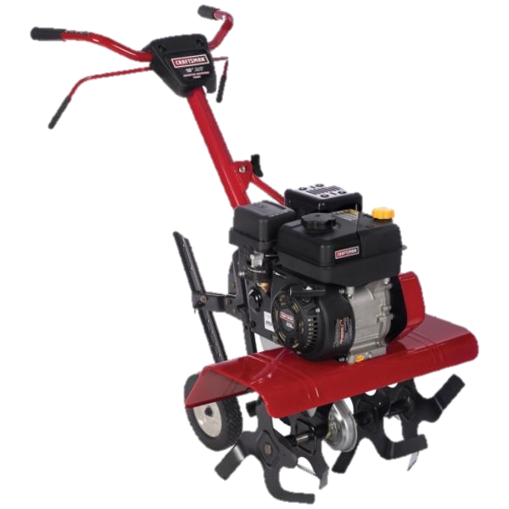
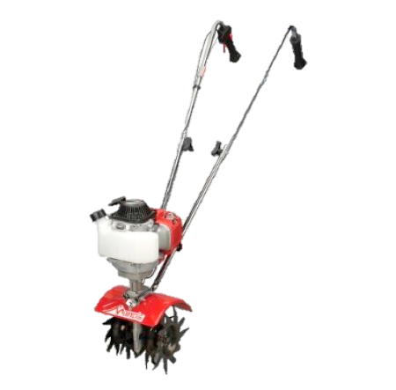
Limited Tilling
Mantis 4 cycle – 8 “
Sears 5 HP front tine – 14 “
Raised beds – top 2 “
With Mantis tiller
Walkways
6” deep with
either tiller

Slide 37
Sunflower fences

Slide 39
Deer Deterrent

Slide 41
Green Manure as Weed deterrents
Buckwheat in Winter Squash
Flax in potato patch

Slide 43
Composting
Villa Kitchen scraps
Yard & garden waste

Slide 45
COMPOST TEA

Slide 46
Foliar Feeding compost tea
DISEASE SUPPRESANT
FERTALIZER

Slide 49
Companion Planting

Slide 54
Crop Rotation

Slide 55
Black Plastic to raise soil temperature

Slide 56
Volunteers & Interns

Slide 57
University Students

Slide 60
Sisters & affiliates
Garlic Harvest Day

Slide 61
Digging

Slide 62
Transporting

Slide 63
Curing & Storing

Slide 64
Produce Used by
Villa St. Joseph
St. Rose Convent
Volunteers

Slide 65
Lead Harvesters
Pole Beans Raspberries
563 lbs. ------- 275 lbs.

Slide 66
Villa Sister Visits
Viterbo U Interns

Slide 68
Identifying Labels
For Visitors

Slide 70
Villa Sister Volunteers shucking the Popcorn

Slide 71
Annual Harvest Meals

Slide 73
Lead Harvesters
Celebrating the Harvest

Slide 75
The
Aesthetics

Slide 82
FSPA Organic
Garden
Welcomes
Visitors
lslinger@fspa.org
608-797-5269
Garden tours
Woods hike
Natural Cemetery
Stars, Planets & Constellation, etc. Telescope Viewing
by La Crosse Area Amateur Astronomy Association
Stargazing event
Sept. 17, 2011
6:00 – 10 p.m.

